Slide 1
Planet imagery and land cover
March 1 2019

Slide 2
Creating and using validation data from Planet imagery
(summary)

Slide 3
Using Planet-derived validation data to answer questions:
Land use validation
What’s the SC vs DC classification accuracy for different soymaps?
What’s the soy vs nonsoy agri classification accuracy for different soymaps?
What is the agri vs natural classification accuracy for different soymaps?
(two soymaps to compare so far: Jake’s + Jake’s with pooled years)
Crop timing validation
Do I need to adjust crop timing estimation method?
What error to assign to crop timing maps?
 | Jake’s soymap | Soymap 1 | Soymap 2 (later)
Training points | Soy_pts_agsat_1 (MT only) | Soy_pts_agsat_1 (MT only), masked with map3 agri | Soy_pts_agsat_1 (MT only), masked with map3 agri PLUS PLOS pts (MT only)
Year pooling | Each year has separate trained classifier | 2004-2017 points are pooled and are applied to 2004 – 2018; 2003 is trained and applied by itself
Input data | MODIS, Landsat | Same as Jake’s soymap
GEE file: LandCover/Planet Do Validation

Slide 4
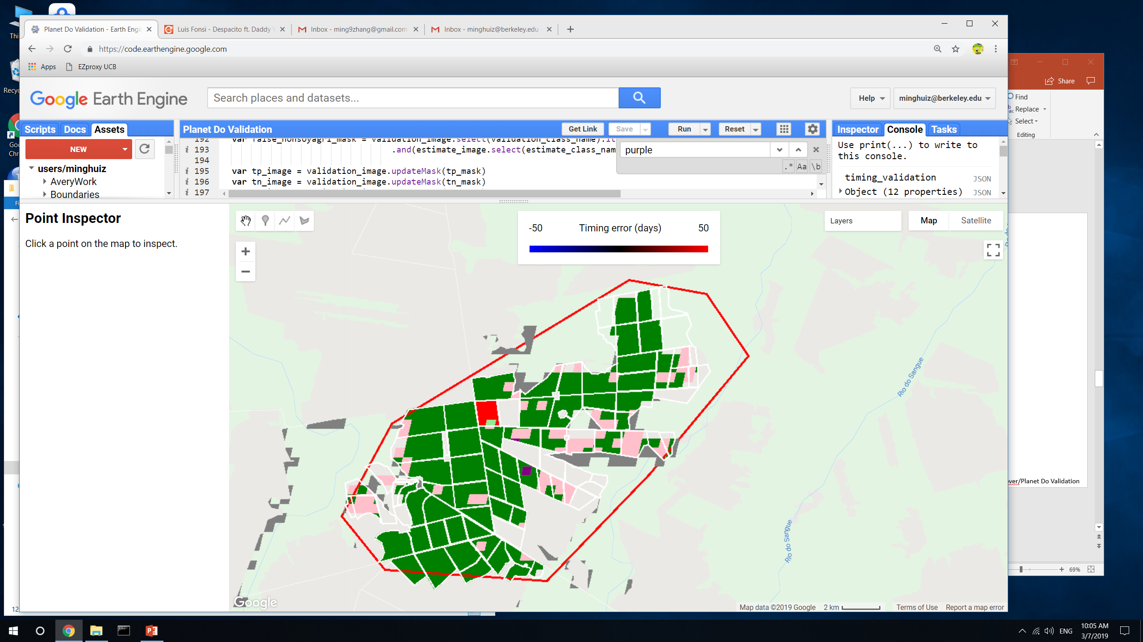
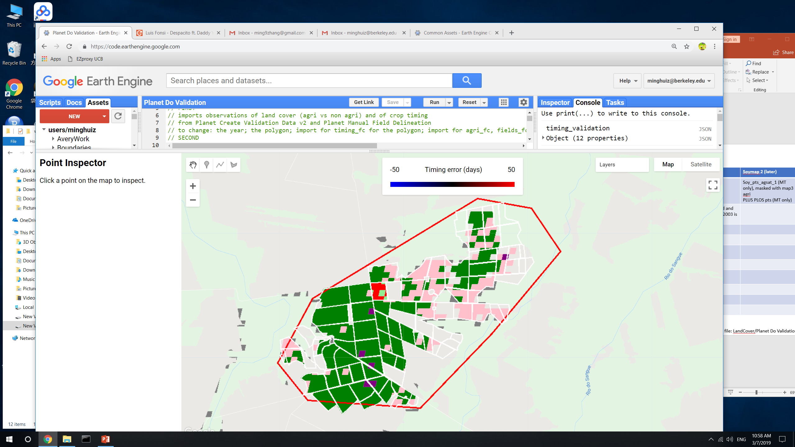
Land classification accuracy for poly5 (MT)
Legend:
True SC = light green
True DC = green
False SC = pink
False DC = red
False nonsoy agri = purple
False agri (actually natural) = gray
All fields except one (the red one) are DC or TC
This region has a lot of soy training points (it was chosen for its soy training point density)
Soymap 1
Jake’s soymap
GEE file: LandCover/Planet Do Validation

Slide 5
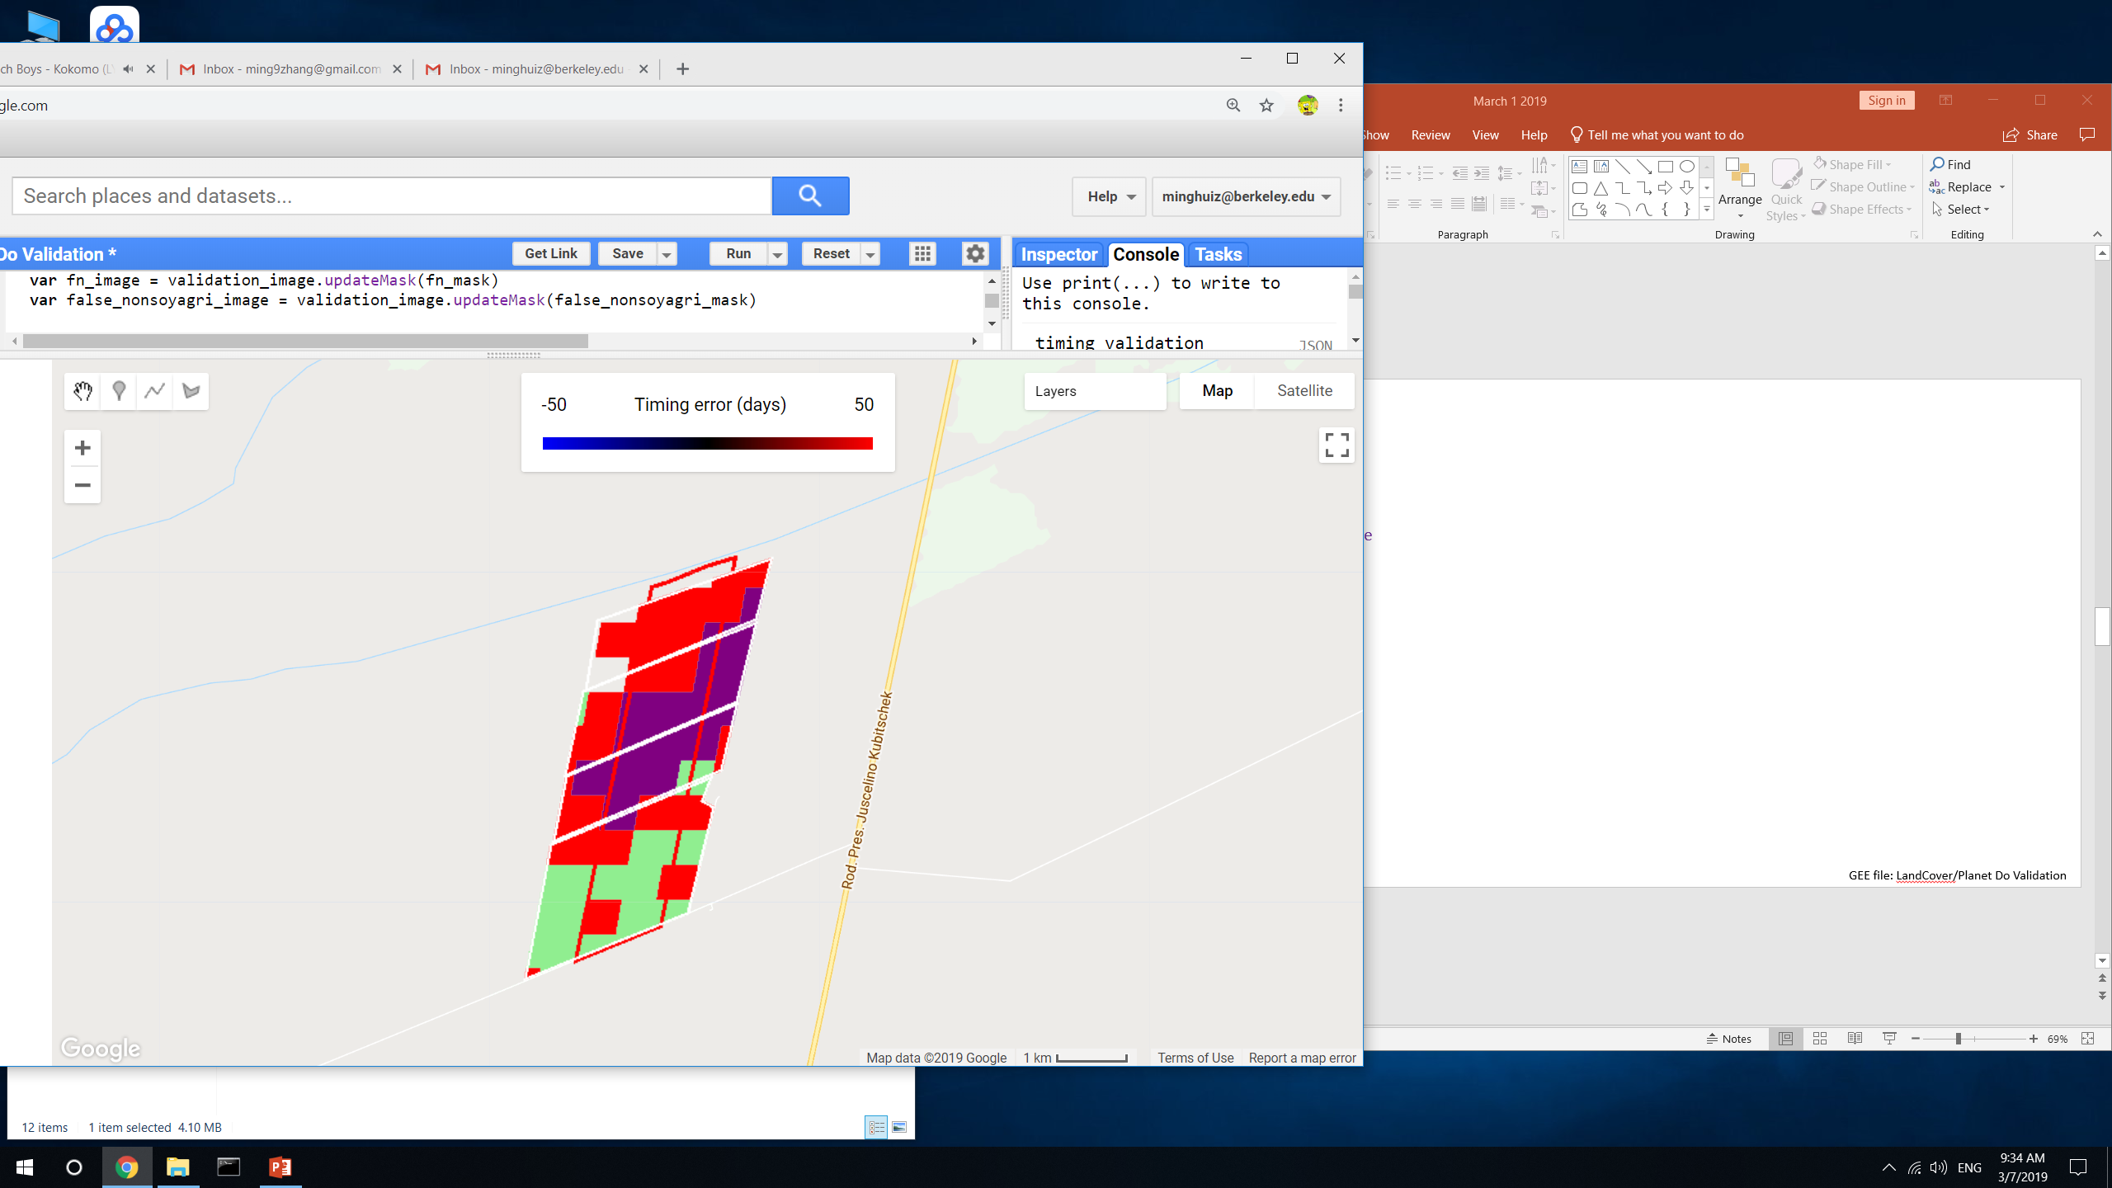
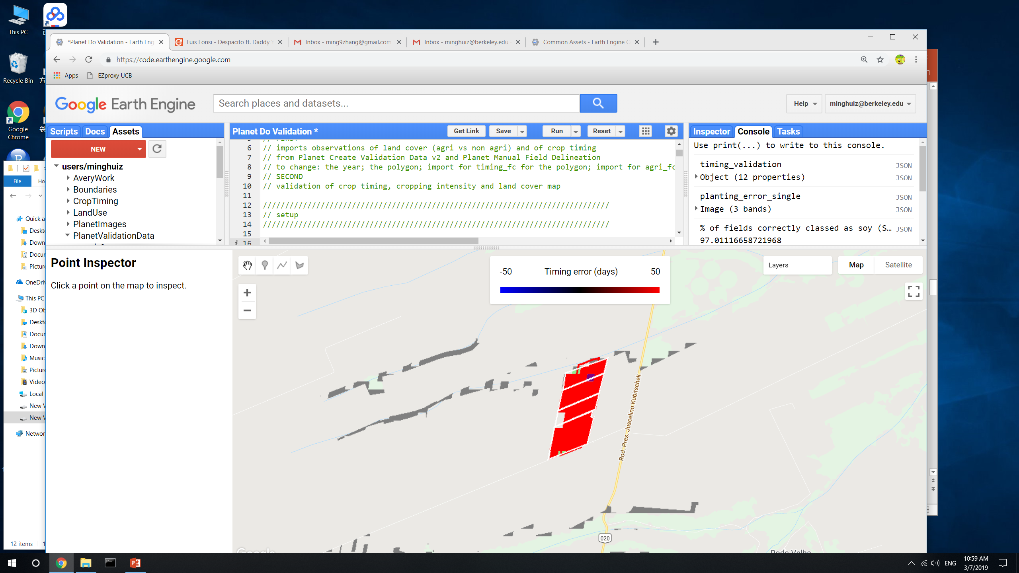
Land classification accuracy for poly3 (Bahia)
Legend:
True SC = light green
True DC = green
False SC = pink
False DC = red
False nonsoy agri = purple
False agri (actually natural) = gray
All fields are SC
This region has no soy training points
Soymap 1
Jake’s soymap
GEE file: LandCover/Planet Do Validation

Slide 6
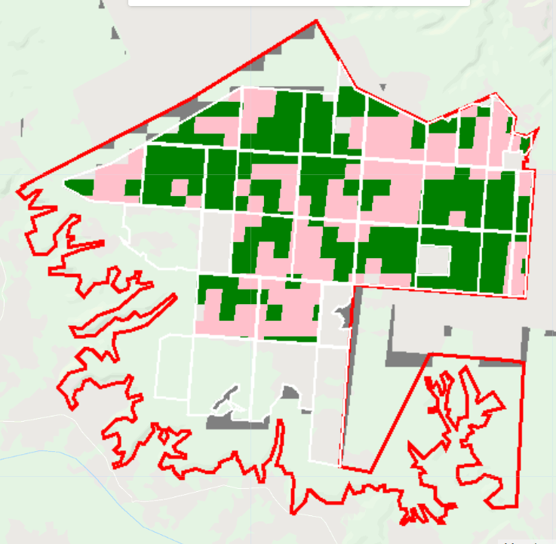
Land classification accuracy for poly1 (Piaui)
Legend:
True SC = light green
True DC = green
False SC = pink
False DC = red
False nonsoy agri = purple
False agri (actually natural) = gray
All fields are DC
This region doesn’t contain soy training points
Soymap 1
Jake’s soymap
(Jake’s soymap doesn’t have 2018)
GEE file: LandCover/Planet Do Validation

Slide 7
SC vs DC accuracy: normalized by area of SC + DC in validation data
Conclusion: it’s better for SC vs DC accuracy to pool years, even where there isn’t training data
 |  | Jake’s soymap | Soymap 1 | Soymap 2 (later)
Training points |  | Soy_pts_agsat_1 (MT only) | Soy_pts_agsat_1 (MT only), masked with map3 agri | Soy_pts_agsat_1 (MT only), masked with map3 agri PLUS PLOS pts (MT only)
Year pooling |  | Each year has separate trained classifier | 2004-2017 points are pooled and are applied to 2004 – 2018; 2003 is trained and applied by itself
Input data |  | MODIS, Landsat | Same as Jake’s soymap
Post classification masking |  | Map2.3 | Map3
Poly1 (Piaui) | True SC | n/a | 0
 | True DC | n/a | 0.56
 | False SC | n/a | 0.39
 | False DC | n/a | 0
Poly3 (Bahia) | True SC | 0.03 | 0.23
 | True DC | 0 | 0
 | False SC | 0 | 0
 | False DC | 0.94 | 0.39
Poly5 (MT) | True SC | 0.007 | 0.003
 | True DC | 0.55 | 0.71
 | False SC | 0.18 | 0.14
 | False DC | 0.015 | 0.02
GEE file: LandCover/Planet Do Validation

Slide 8
Soy vs nonsoy agri accuracy
NOTE: assumed that all fields are soy; tested whether land use map classifies all fields as soy
Takeaway: made a big assumption, so it’s unclear which soy map is better
 |  | Jake’s soymap | Soymap 1 | Soymap 2 (later)
Training points |  | Soy_pts_agsat_1 (MT only) | Soy_pts_agsat_1 (MT only), masked with map3 agri | Soy_pts_agsat_1 (MT only), masked with map3 agri PLUS PLOS pts (MT only)
Year pooling |  | Each year has separate trained classifier | 2004-2017 points are pooled and are applied to 2004 – 2018; 2003 is trained and applied by itself
Input data |  | MODIS, Landsat | Same as Jake’s soymap
Post classification masking |  | Map2.3 | Map3
Poly1 (Piaui) | % fields correctly classed as soy | n/a | 95
 | % fields incorrectly classed as nonsoy agri | n/a | 0
Poly3 (Bahia) | % fields correctly classed as soy | 97 | 62
 | % fields incorrectly classed as nonsoy agri | 3 | 35
Poly5 (MT) | % fields correctly classed as soy | 76 | 88
 | % fields incorrectly classed as nonsoy agri | 1 | 0.35
GEE file: LandCover/Planet Do Validation

Slide 9
Agri vs natural accuracy
Takeaway: unclear which soymap is better, but agri vs natural veg accuracy isn’t a huge concern
 |  | Jake’s soymap | Soymap 1 | Soymap 2 (later)
Training points |  | Soy_pts_agsat_1 (MT only) | Soy_pts_agsat_1 (MT only), masked with map3 agri | Soy_pts_agsat_1 (MT only), masked with map3 agri PLUS PLOS pts (MT only)
Year pooling |  | Each year has separate trained classifier | 2004-2017 points are pooled and are applied to 2004 – 2018; 2003 is trained and applied by itself
Input data |  | MODIS, Landsat | Same as Jake’s soymap
Post classification masking |  | Map2.3 | Map3
Poly1 (Piaui) | (area natural veg classed as agri)/(total area area)*100 | n/a | 0.16
Poly3 (Bahia) | (area natural veg classed as agri)/(total area area)*100 | 0.17 | 0.17
Poly5 (MT) | (area natural veg classed as agri)/(total area area)*100 | 3.7 | 6.3
GEE file: LandCover/Planet Do Validation

Slide 10
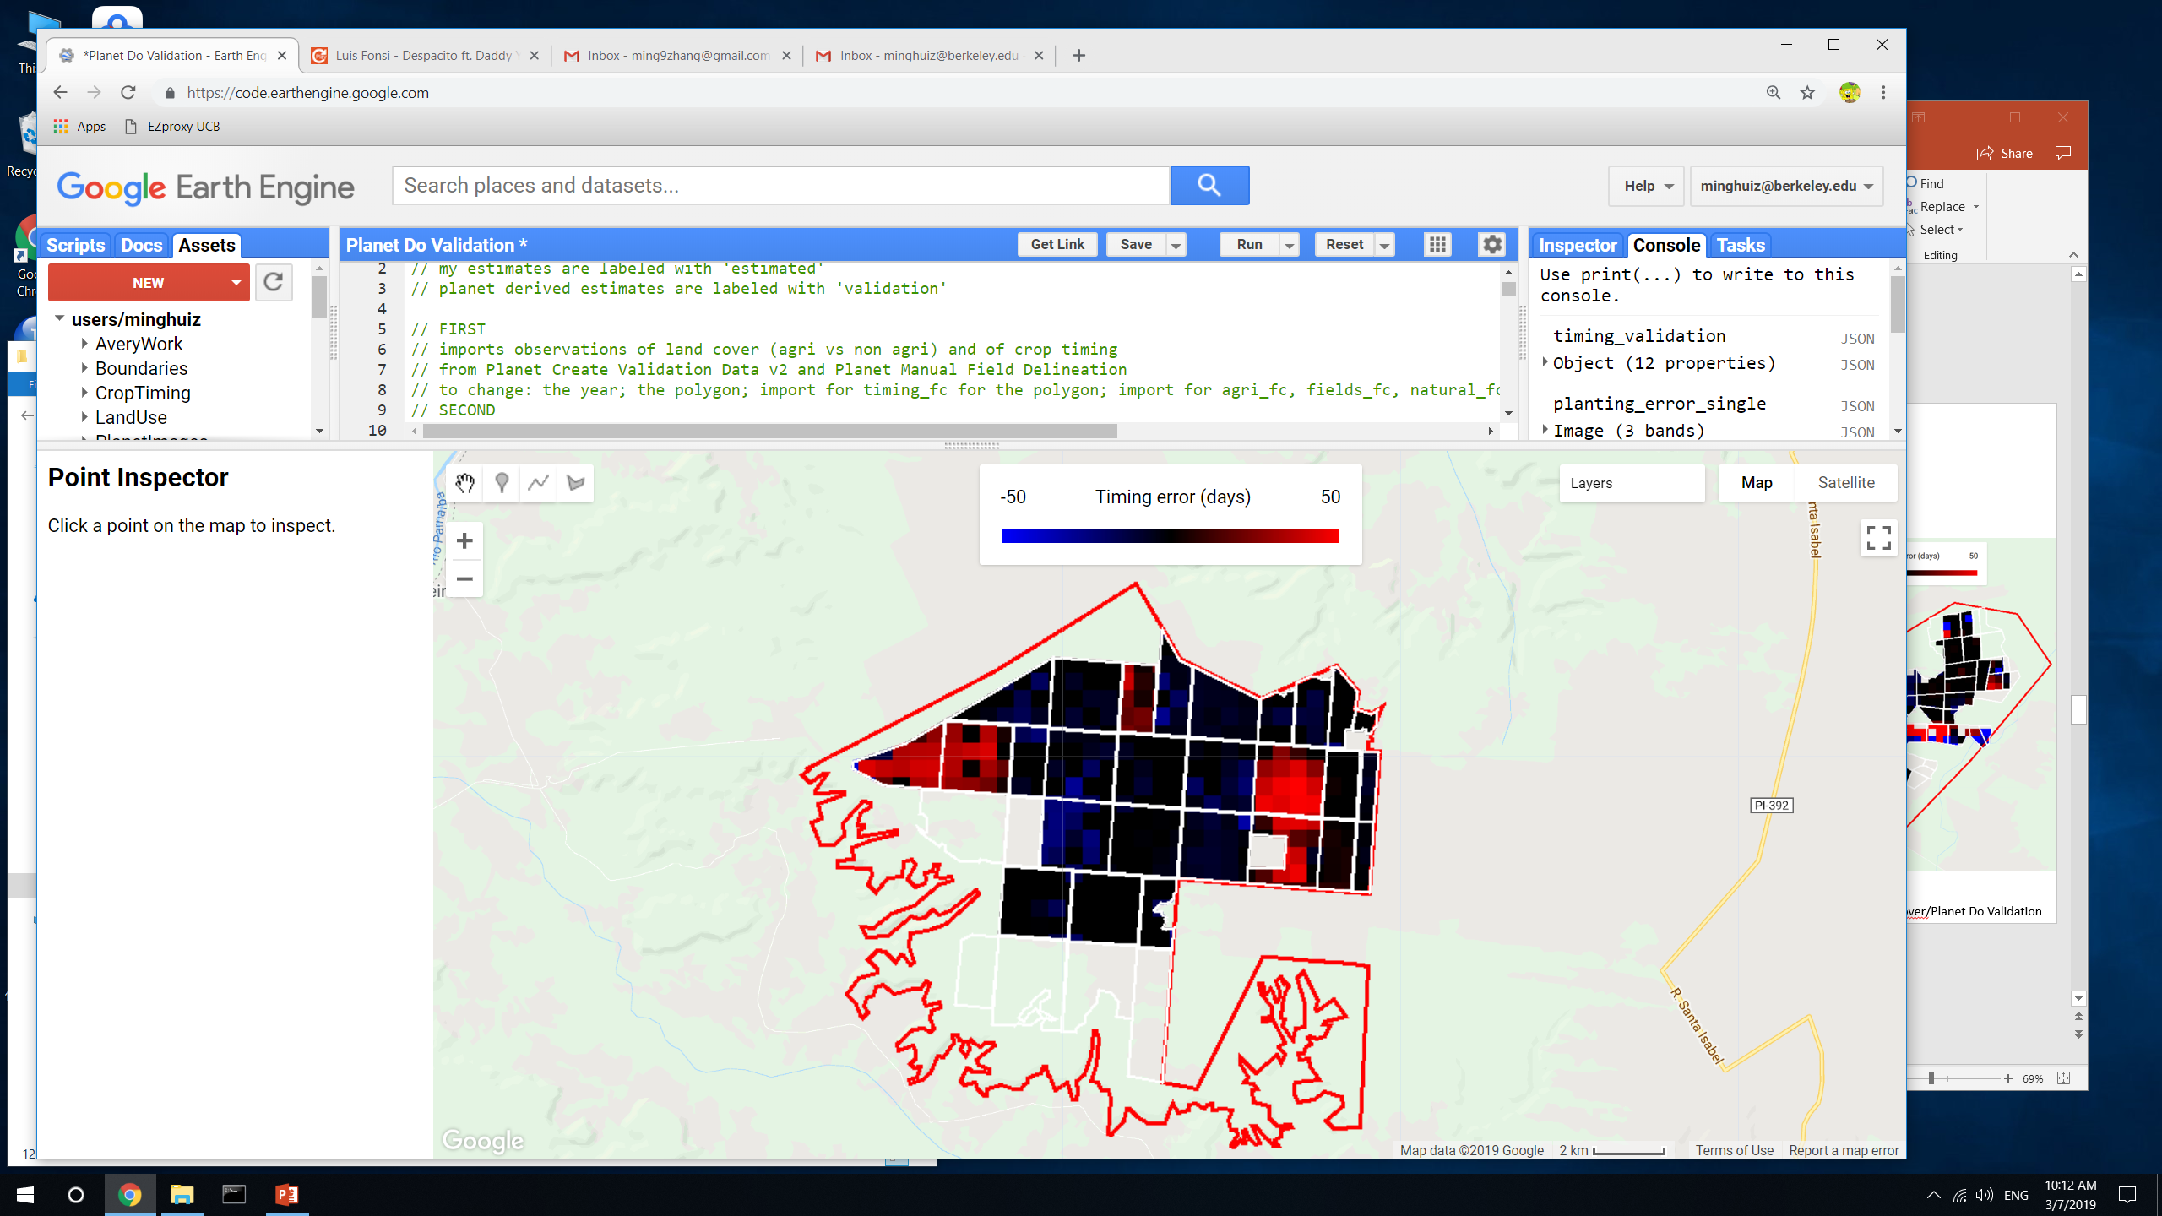
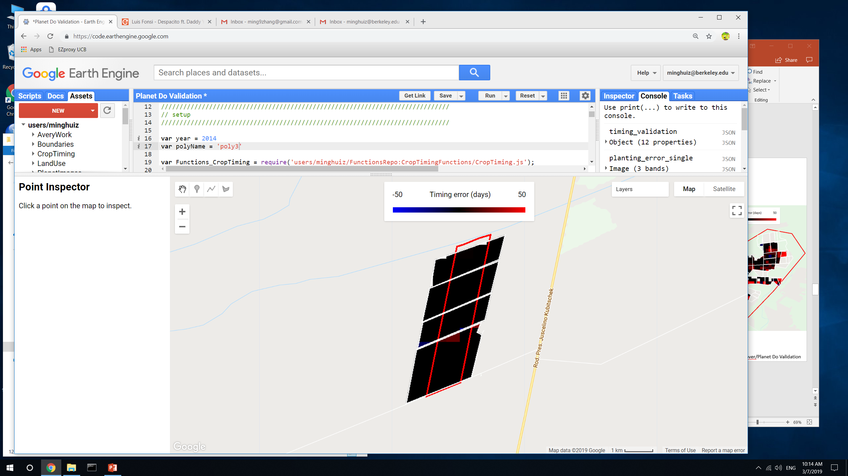
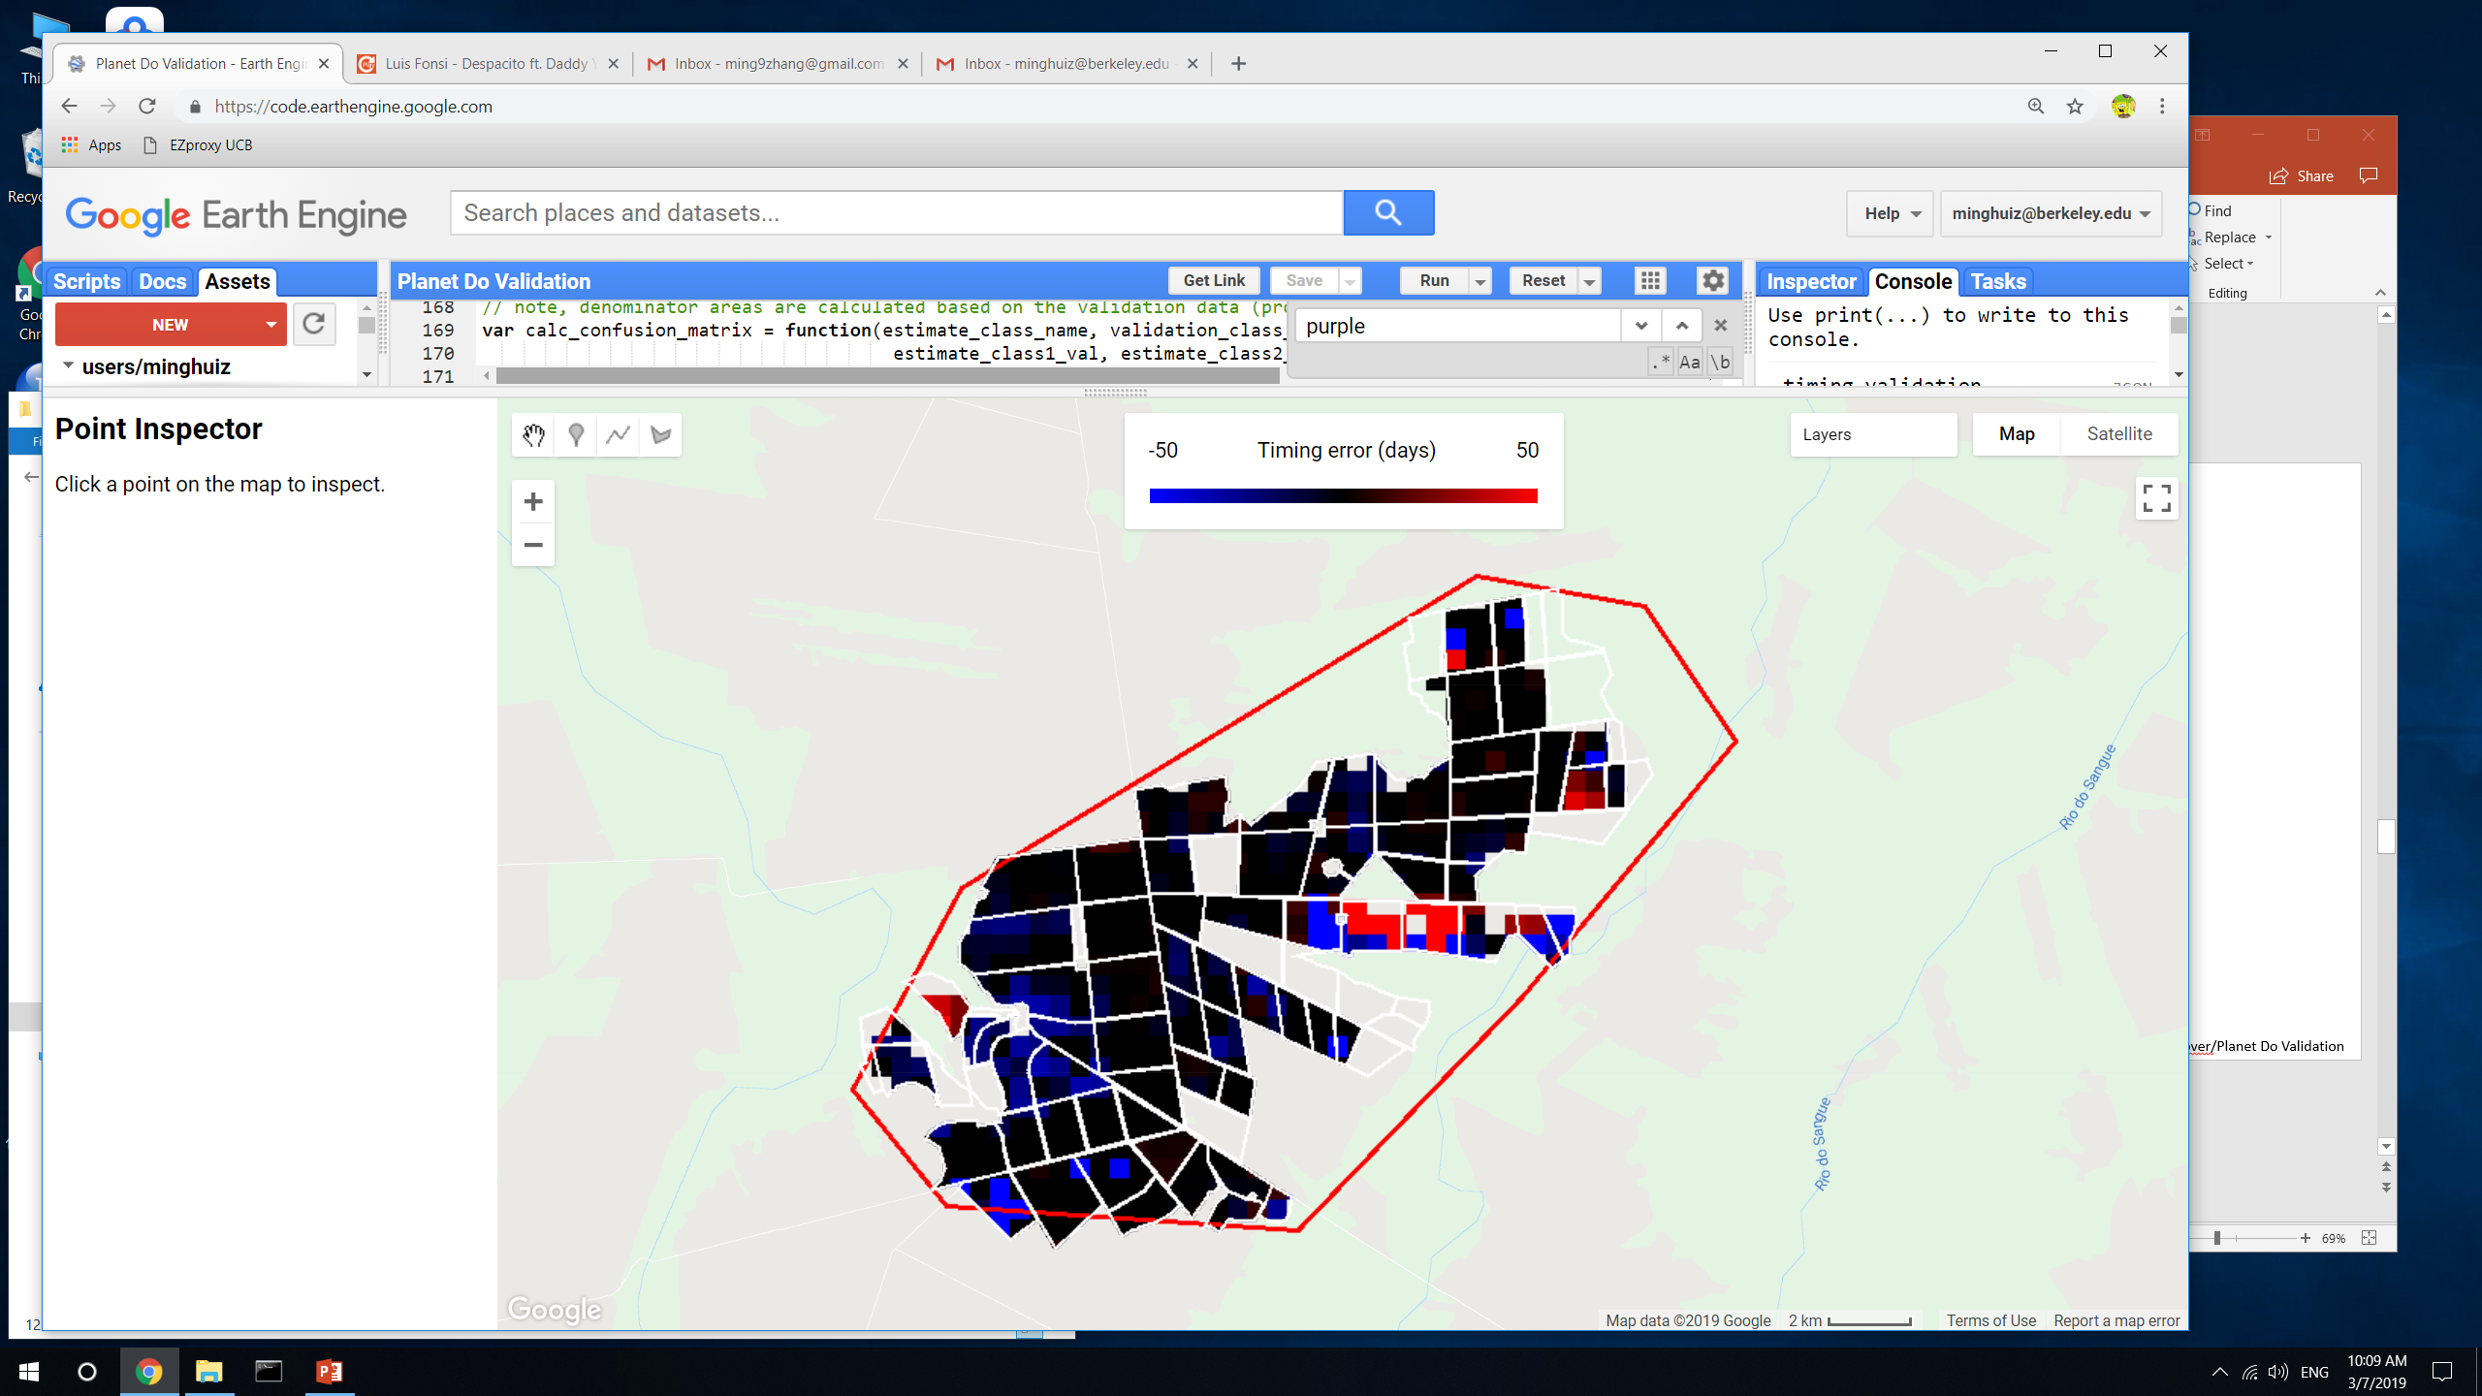
Planting (first crop) range error (days between estimate and nearest validation data point)
poly1 (Piaui)
poly3 (Bahia)
poly5 (MT)
GEE file: LandCover/Planet Do Validation

Slide 11

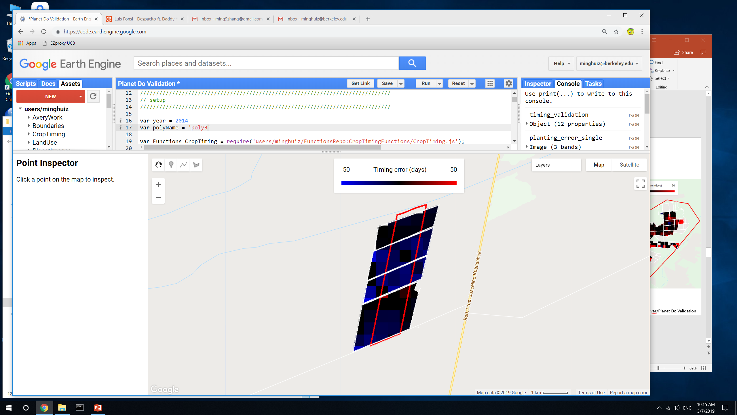
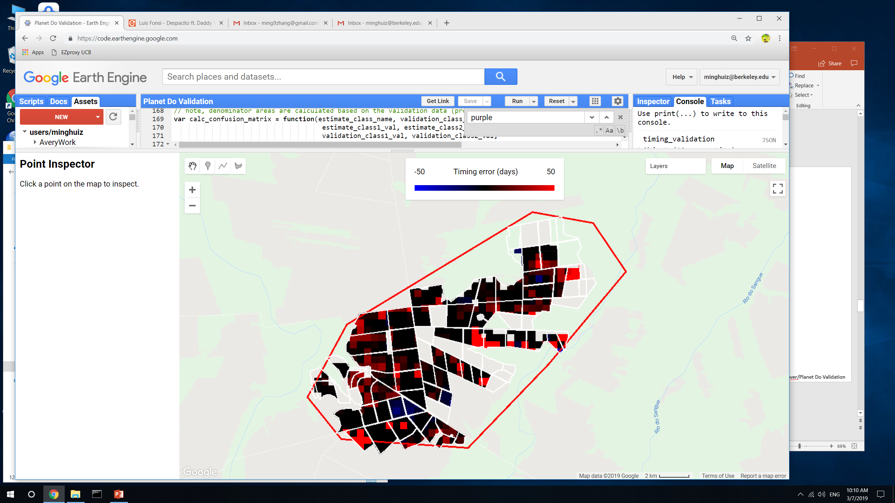
Harvest (first crop) range error (days between estimate and nearest validation data point)
poly1 (Piaui)
poly3 (Bahia)
poly5 (MT)
GEE file: LandCover/Planet Do Validation

Slide 12
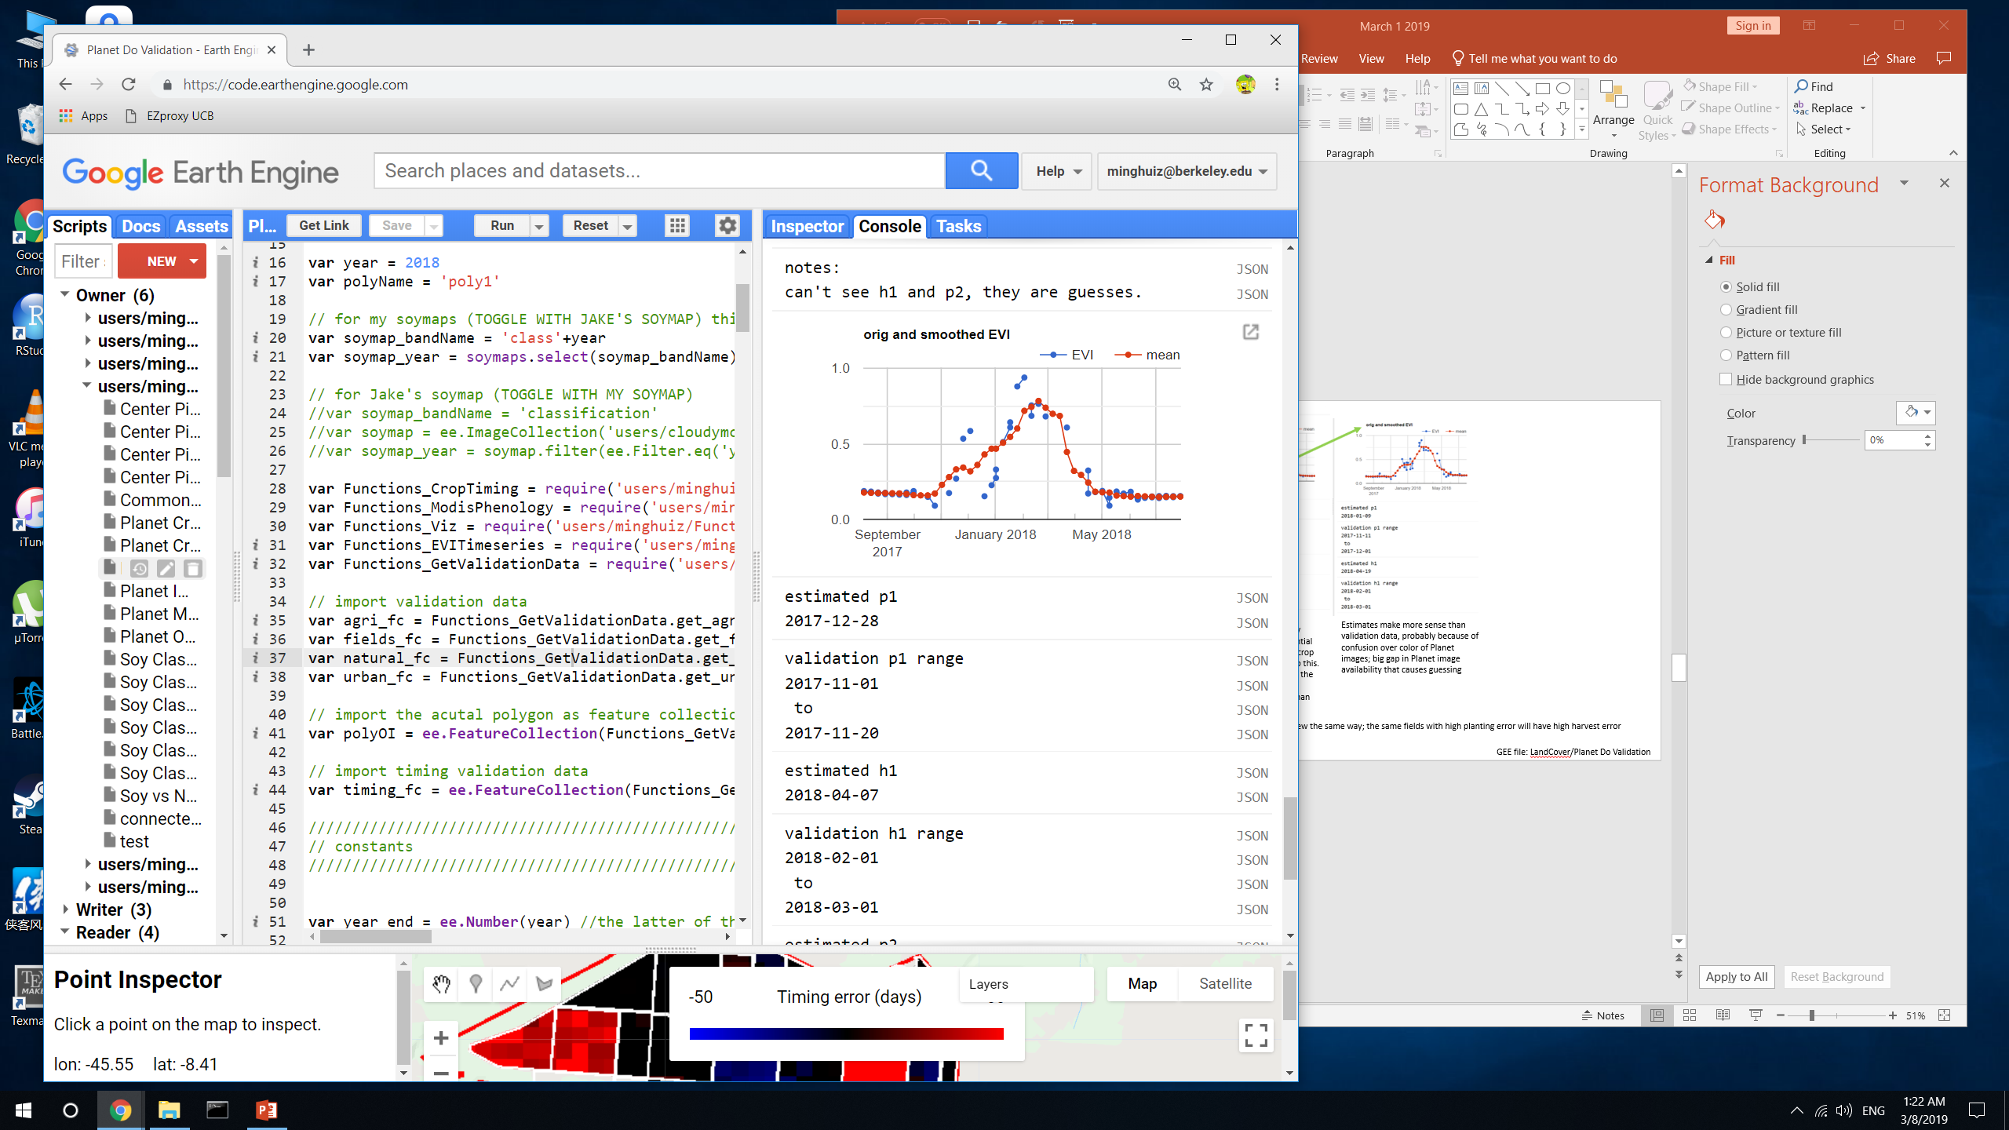
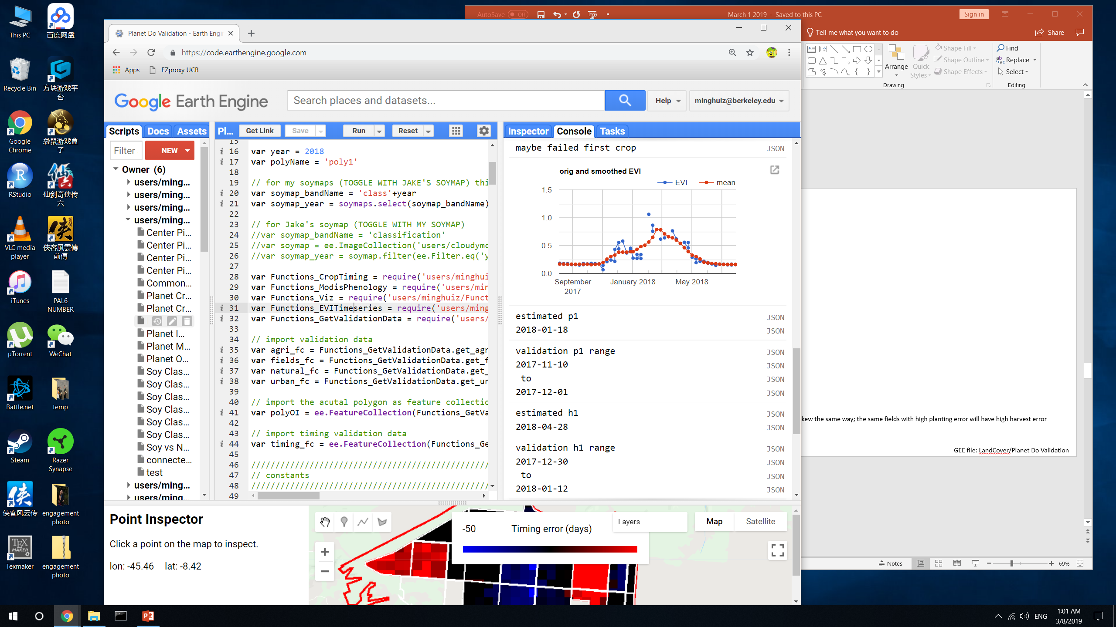
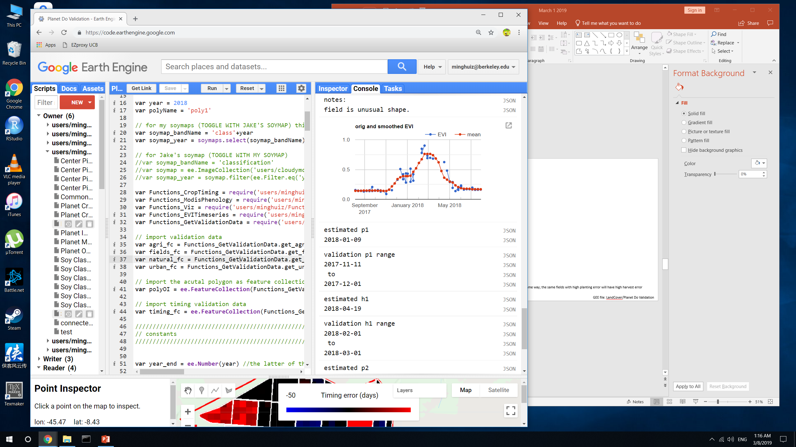
Crop timing examples
poly1 (Piaui)
Plant 1 error
Harvest 1 error
The validation data corresponds to an impossibly short cycled crop/weed/failed first crop.
Need to streamline what I call the ‘first crop’
Estimates make more sense than validation data
Big gap in Planet image availability and confusion over color (green vs brown) -> bad validation data
Lack of Planet imagery during an important time + unfortunate guesses -> bad validation data
Validation p1 was affected by the first peak; validation h1 was a bad guess based on crop cycle + p1
Planting and harvest errors skew the same way; the same fields with high planting error usually have high harvest error
When there’s a large error, it’s quite likely the validation data was bad, not the estimate
GEE file: LandCover/Planet Do Validation

Slide 13
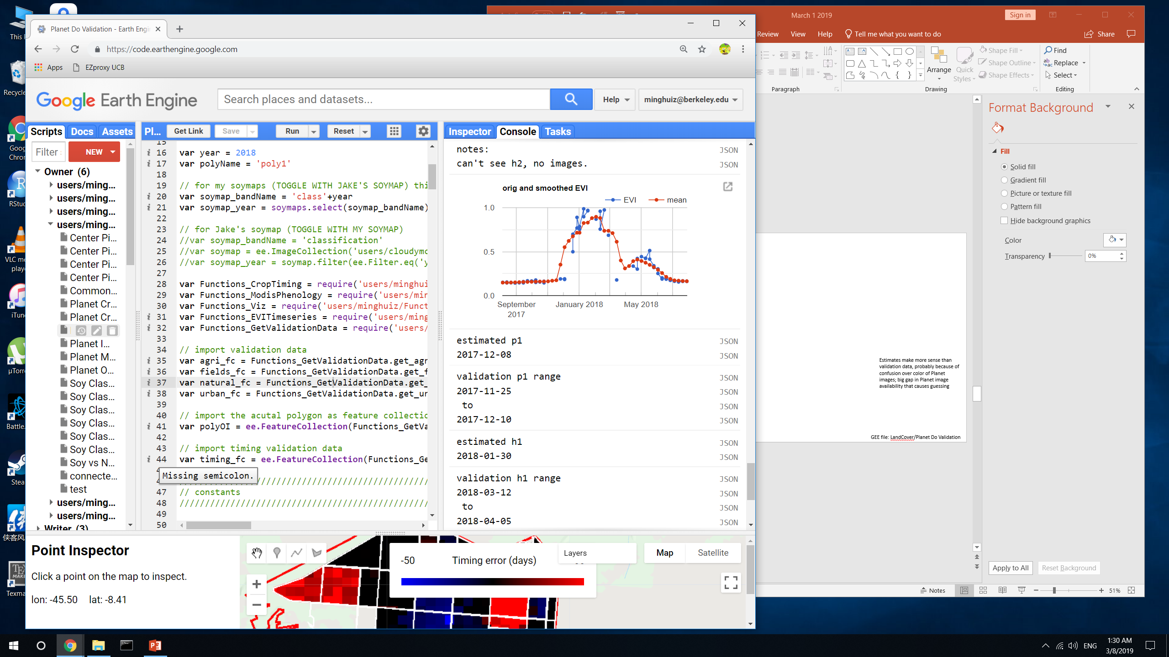
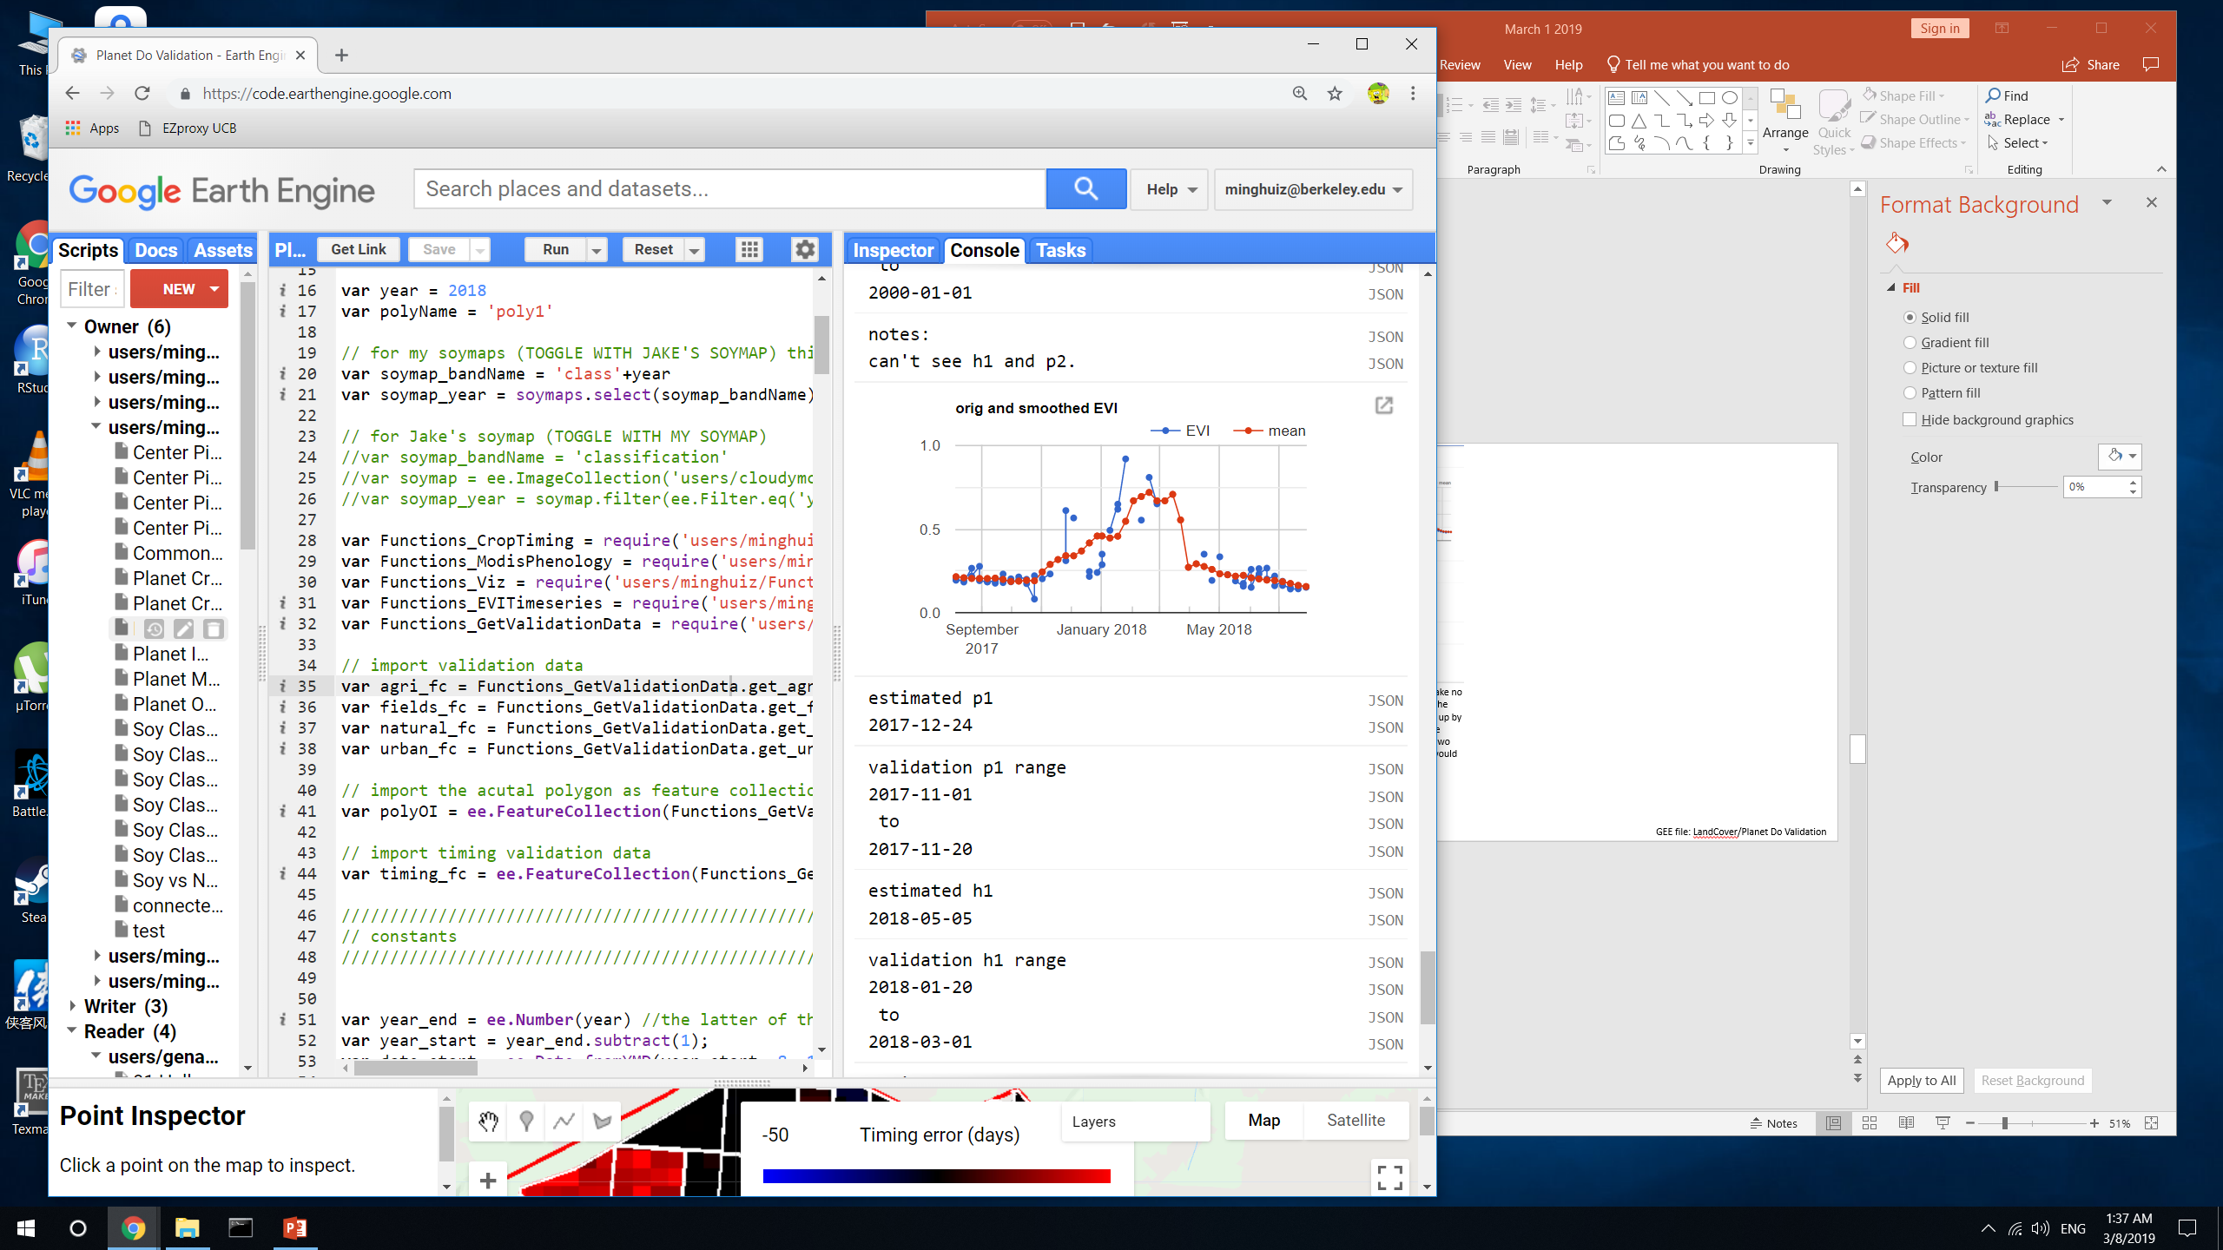
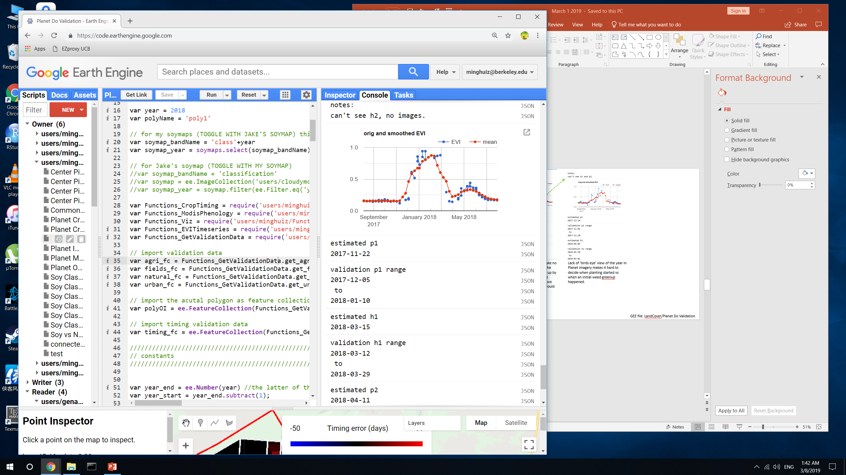
Crop timing examples
poly1 (Piaui)
Plant 1 error
Harvest 1 error
Validation p1 is late, probably because couldn’t decide if a field was ‘green’ yet
The estimates are erroneous – but this would be masked out for its 2-month crop cycle.
h1 happens at the peak EVI. The confidence of h1 is high (only two week interval) – so this error would be picked up
Need a ‘birds eye’ view of the year in addition to Planet imagery to decide when planting started vs when an initial weed greenup happened.
When the estimated dates are truly erroneous, they would have been masked out for their unreasonable crop cycles
GEE file: LandCover/Planet Do Validation

Slide 14
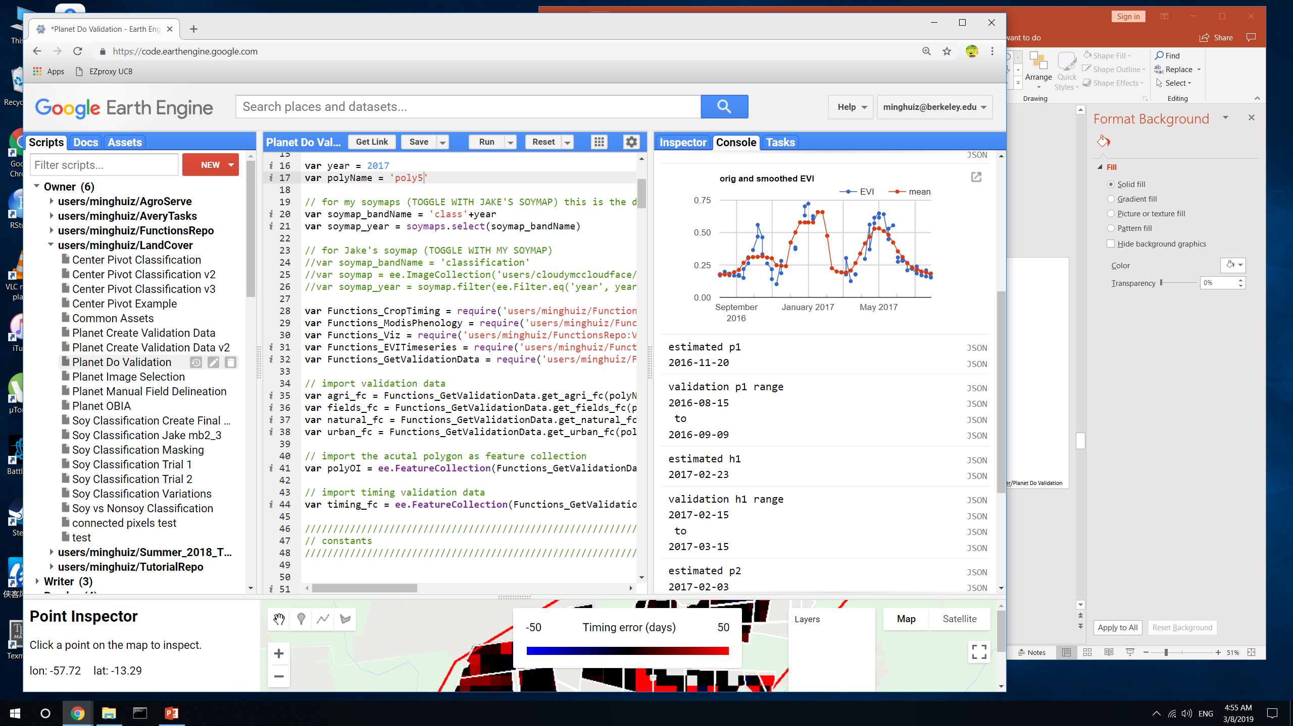
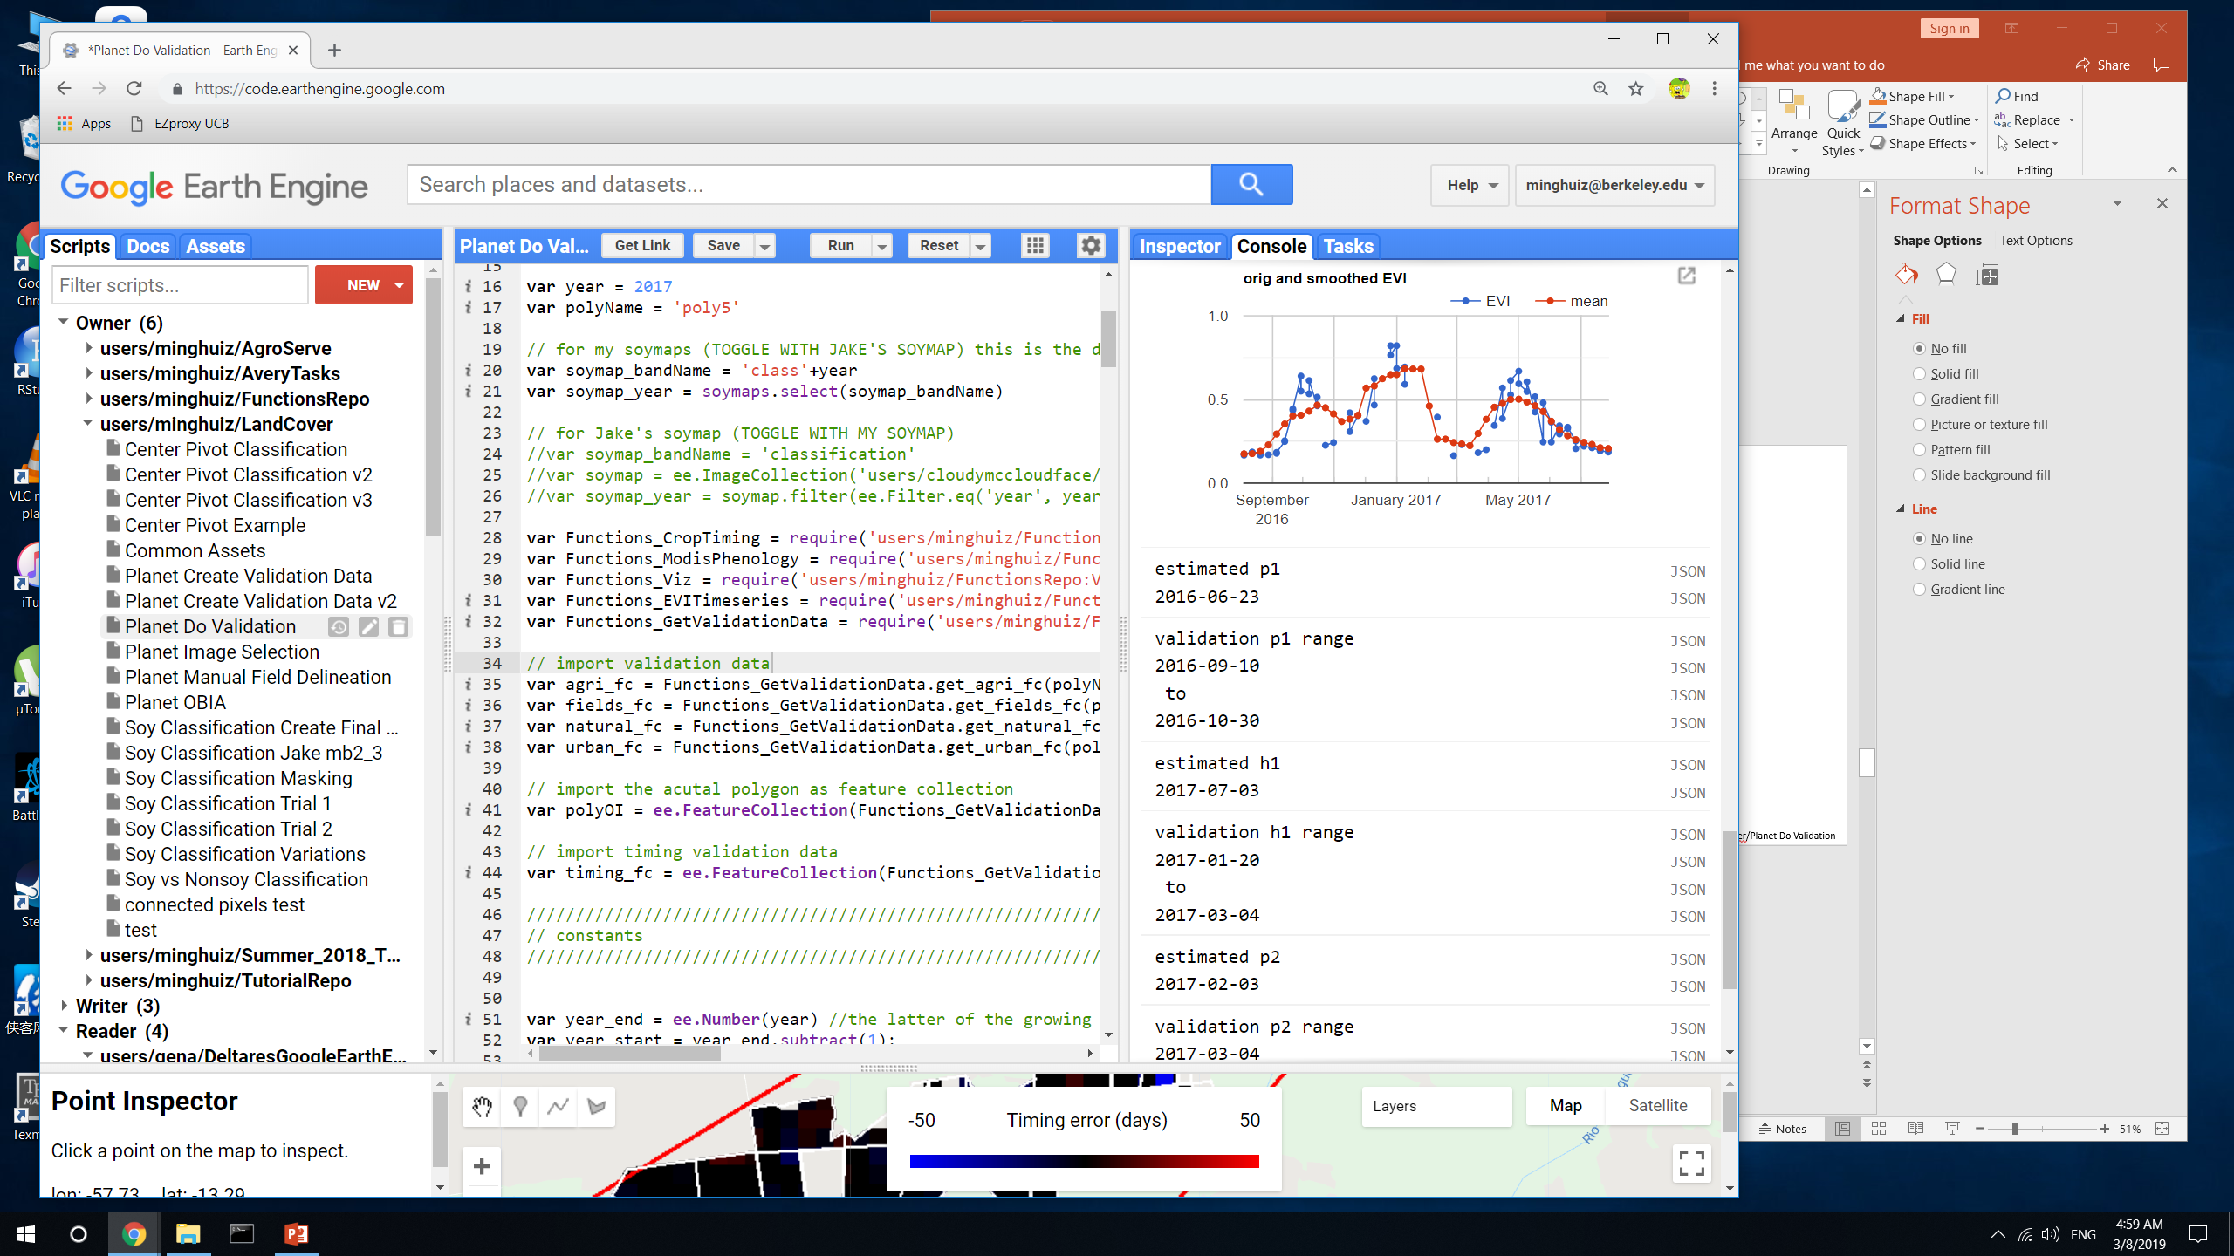
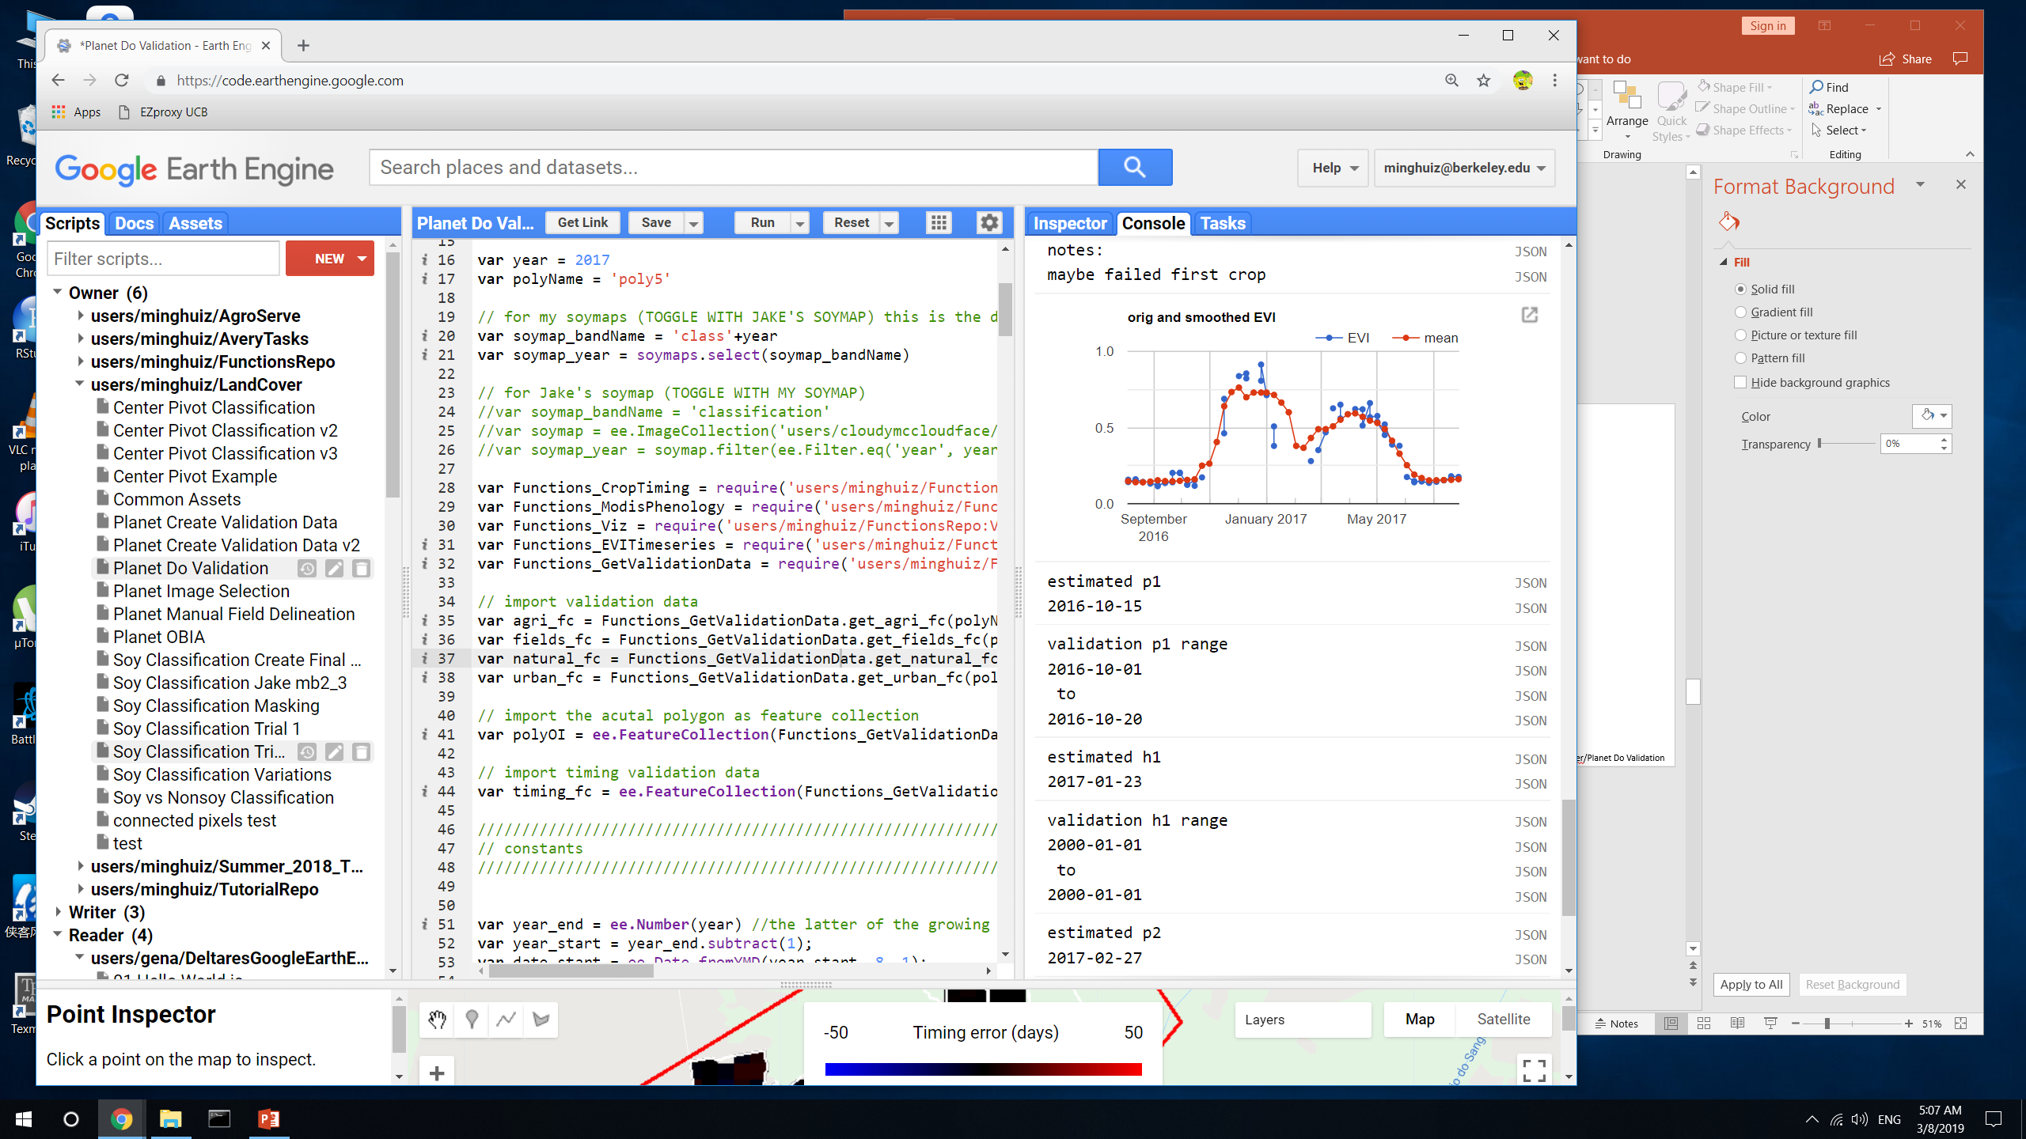
Crop timing examples
Poly5 (MT)
Plant 1 error
Harvest 1 error
Planet didn’t show triple cropping, created error in validation data.
In validation data, p1 is for first crop and h1 is for second crop
Estimation lumped the all three crops as a single crop cycle.
The resulting crop cycle is more than one year long and would be taken out in final timing map.
Example of something that worked well for both the estimate and validation data
The two TC pixels have the same error, but for different reasons: either the validation data or the estimated timing was wrong.
To generate SC/DC/TC data, need MODIS timeseries in addition to Planet images
GEE file: LandCover/Planet Do Validation

Slide 15
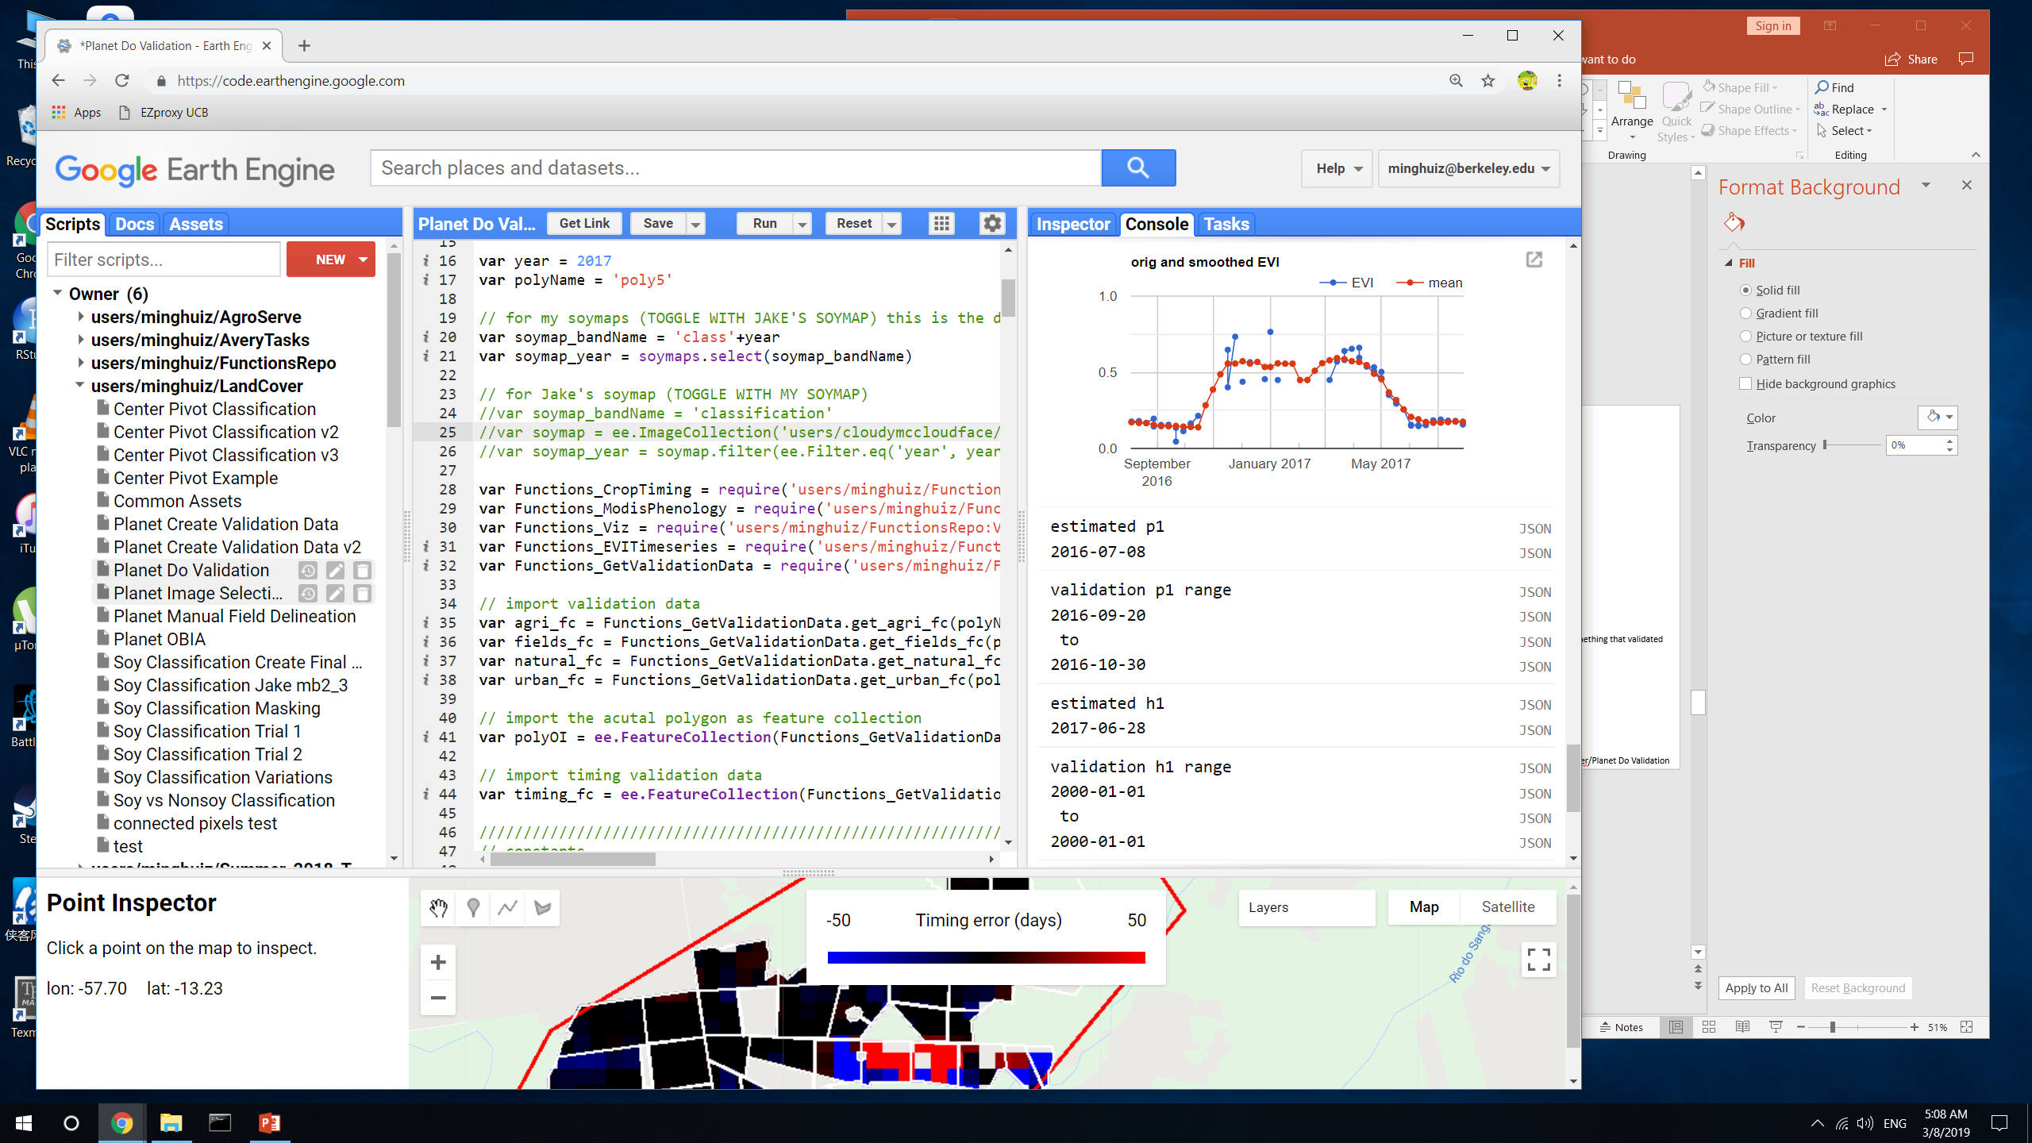
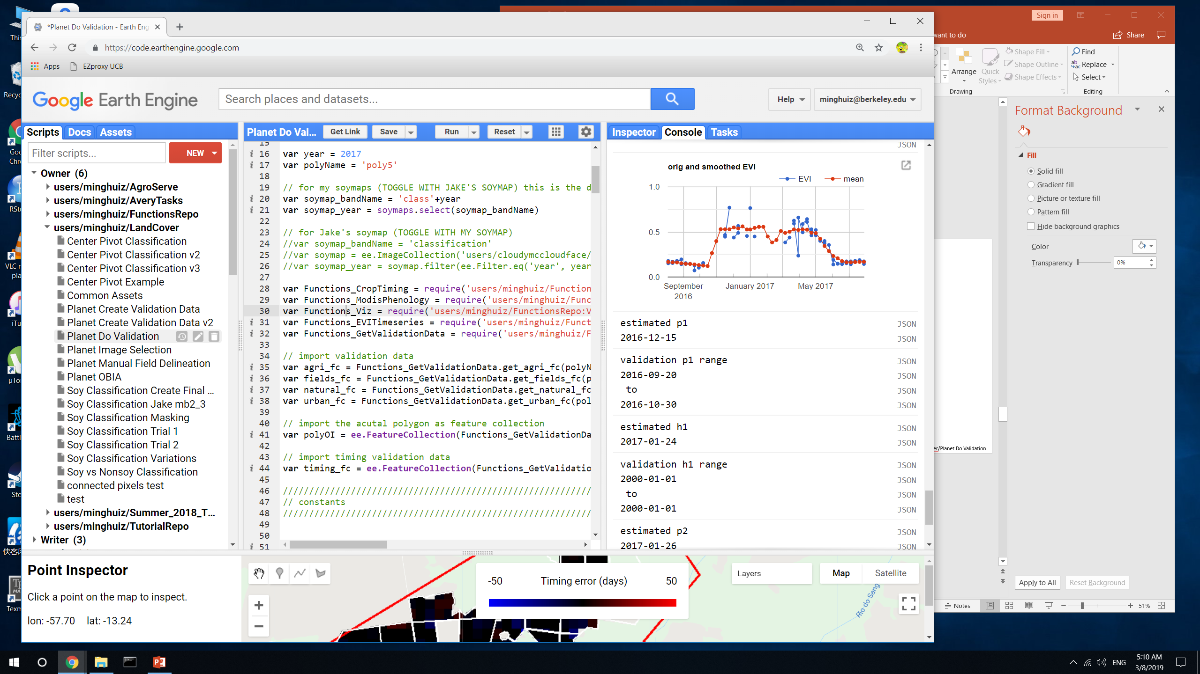
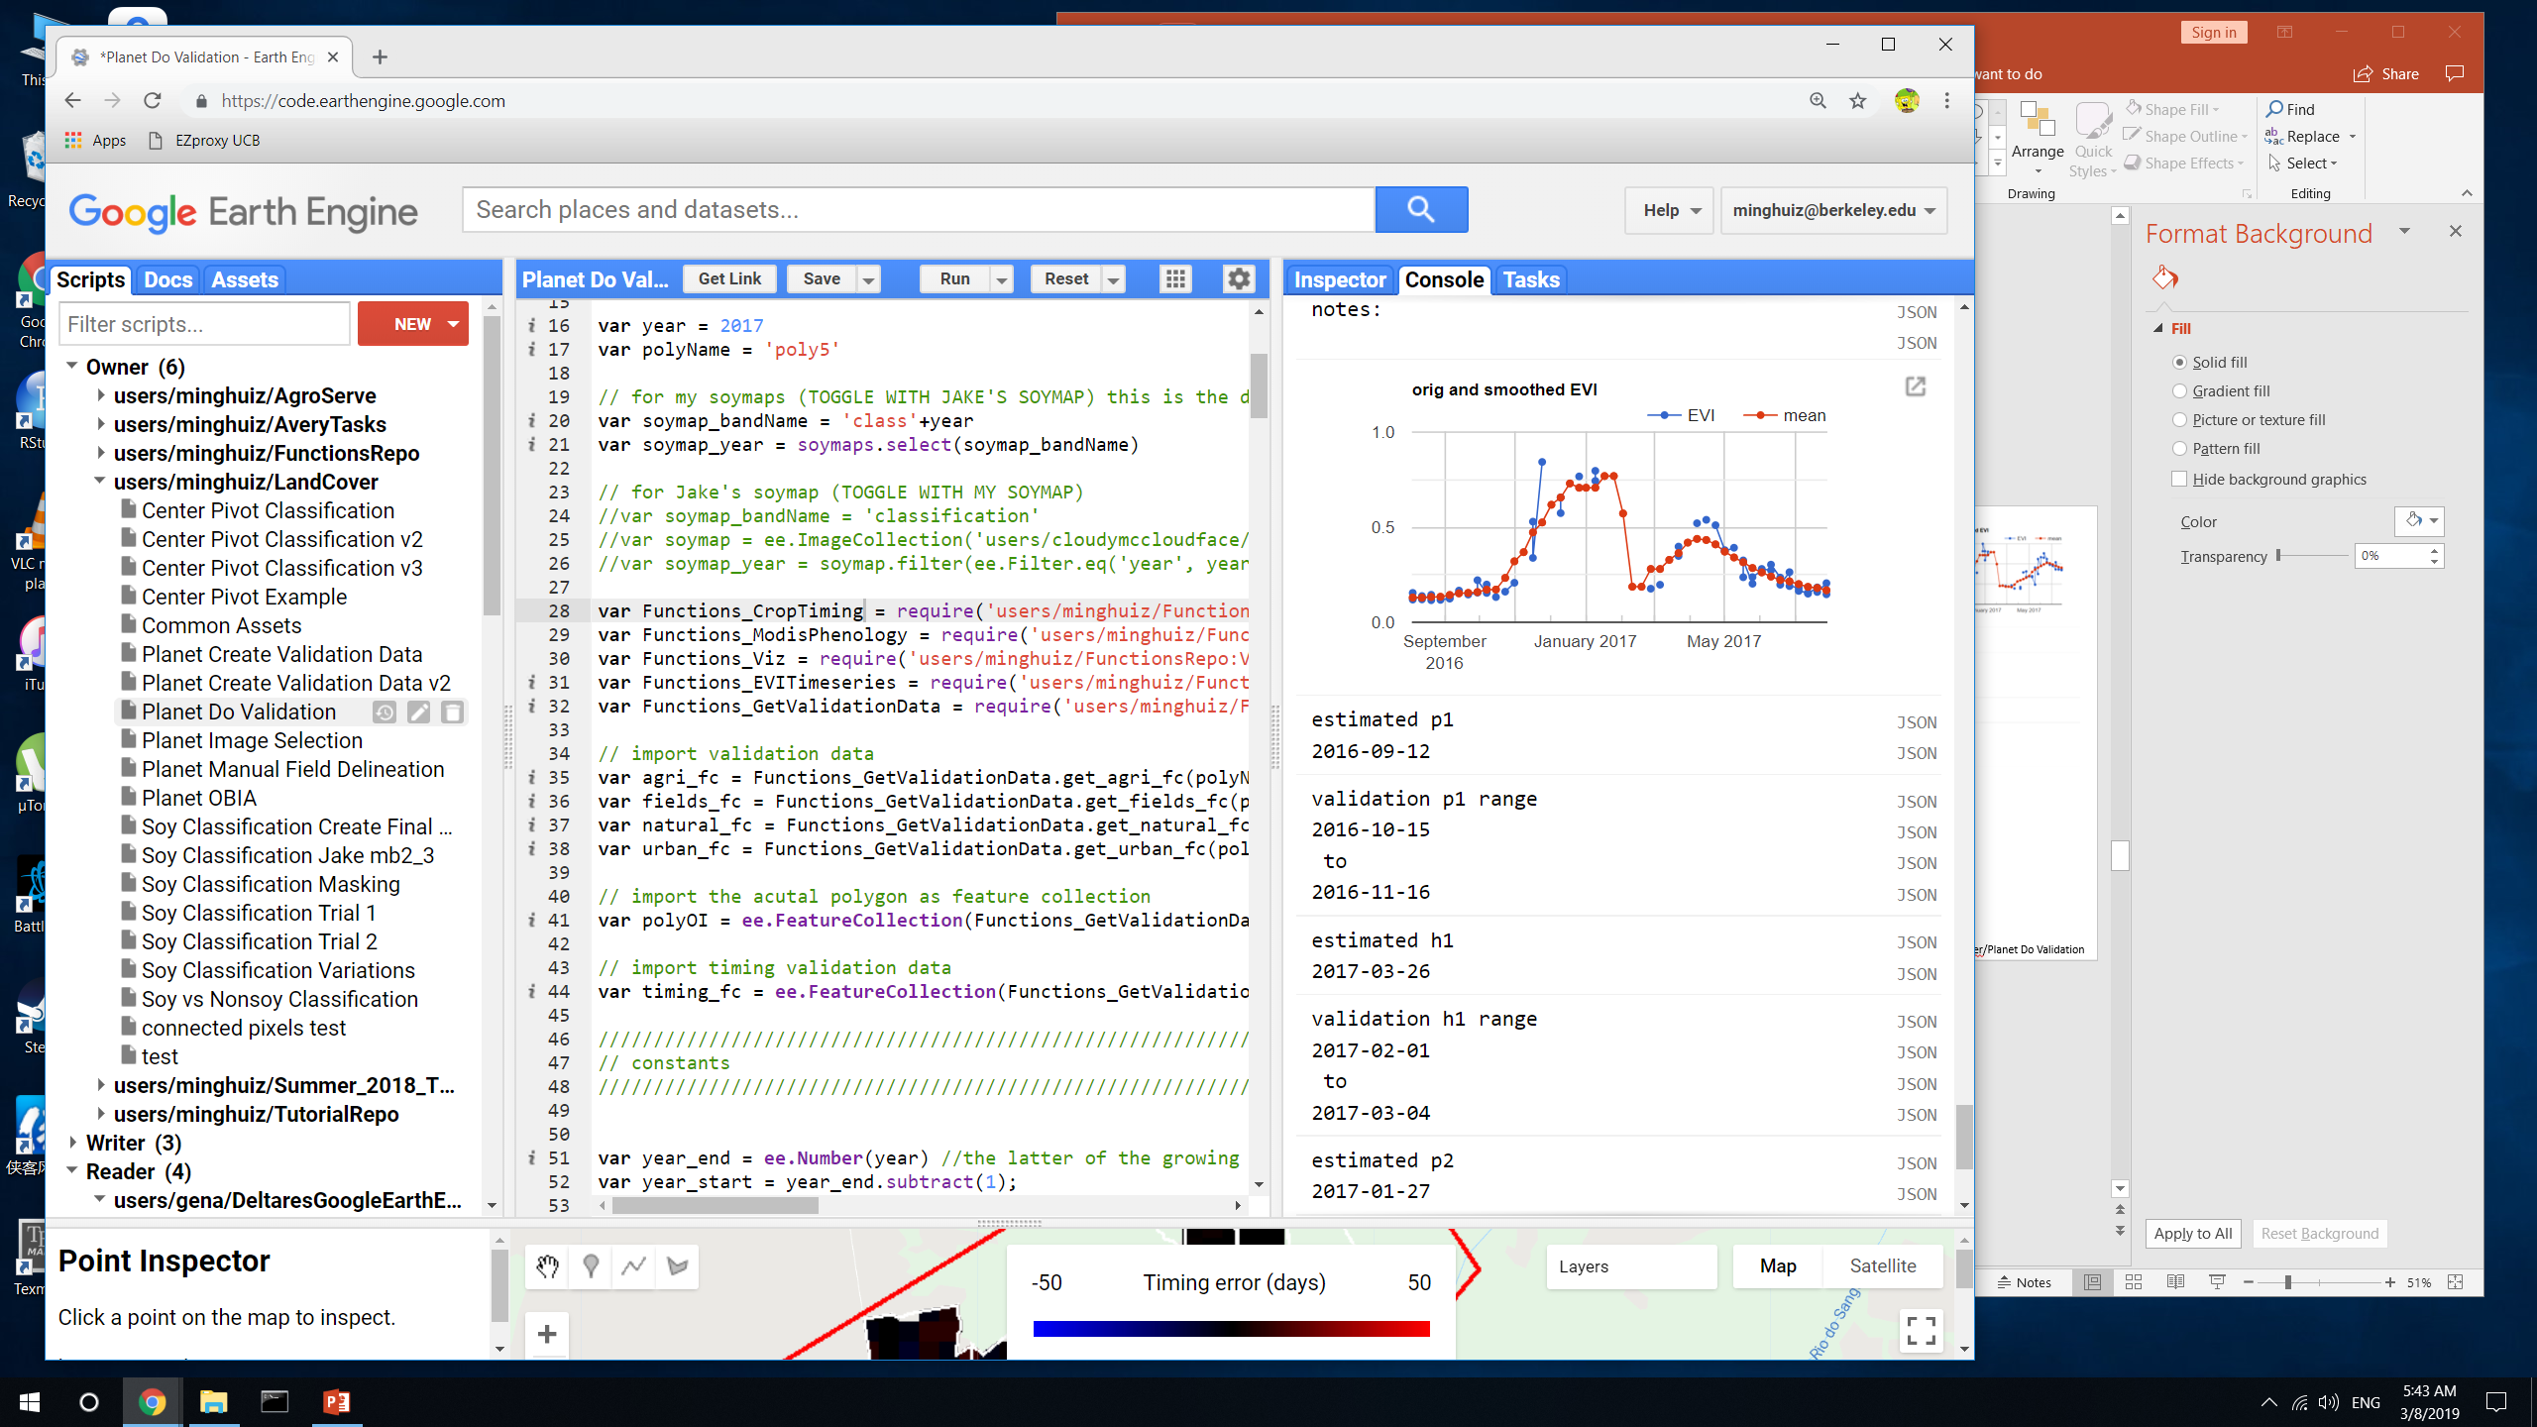
Crop timing examples
Poly5 (MT)
Plant 1 error
Harvest 1 error
Estimate would be masked out due to long crop cycle
Pixel was double cropped, but the middle dip was smoothed out in the estimate.
Estimate would be masked out due to short crop cycle
Validation h1 makes more sense than estimated h1. At 6.5 months, this would probably be masked out based on crop cycle length.
Errors in estimate can vary widely for a similar timeseries (in the same field), but they can be masked out based on crop cycle
GEE file: LandCover/Planet Do Validation

Slide 16
Takeaways
Land cover
Jake’s method doesn’t separate SC/DC as well as my soymap in both MT and Matopiba
Jake’s method seems to do better with soy vs nonsoy agri separation in Matopiba, but need more validation data
Matopiba has significant SC/DC separation challenges, so need more training data
The separation between agri and natural veg isn’t a big issue
Crop timing
Accuracy of crop timing estimates doesn’t directly correspond to accuracy of land use map, so land use map is more to separate SC/DC behavior, not to improve the pixel level estimates themselves
Although the timeseries analysis method does generate big errors, they would be masked out due to crop cycle.
The main issue is to clean up validation data, because some are based on guesses when there are 1.5+ month gaps in Planet imagery and sometimes atmospheric effects + sensor effects influence whether a field ‘looks green’ vs ‘bare’
Even after cleaning, the validation data for planting will have a range of 3-4 weeks; for harvest error will be 2-3 weeks.
Need to do regression on aggregated crop timing stats?
Do regression by chunks of time (e.g. months)?
Attach an error distribution to estimates?
Report greenup instead of planting date to decrease error?
Only need a few more polygons’ worth of plant/harvest validation data.
Purpose is to look for more ‘error cases’, not adjust timeseries analysis method.
Error is unlikely to get smaller, even with highest possible quality validation data.
GEE file: LandCover/Planet Do Validation

Slide 17
Next
Crop timing
Clean + mask validation data to create ‘high confidence’ dataset
Mask out validation data that doesn’t match up with MODIS timeseries
Mask out validation data based on the width (in days) of the validation range, which is the current proxy for confidence level
Attach a ‘confidence level tag’ when generating new validation data
Clean + mask crop timing estimates based on crop cycle + peak timing
Attach error distributions to crop timing estimates
At pixel and field/aggregated scale
Based on width of validation range and ‘range error’
Do all pixels/cells have the same error?
Separate errors for p1, (h1 + p2), and h2 (due to likelihood of clouds impacting TS analysis)
Create SC/DC training and validation data
Delineate fields from Planet images in Matopiba and Mato Grosso
Look at MODIS EVI timeseries over these fields, in addition to Planet images, to determine crop intensity
Download Planet images over wider area, fewer dates.
Given the wide range of soy, soy-corn, weed/starter crop-soy-corn timing, it probably doesn’t matter much whether we are sure a crop is soy.
Create field scale SC/DC/TC data
Use as training points for soymap
Create soy vs nonsoy agri training and validation data
Separate MT training points as soy, nonsoy agri (PLOS points have specific nonsoy crops)
Look for spectral, phenological and visual differences among crops
Create training data
New soymaps
Use PLOS training data + previous soy_pts_agsat_1 training data
Center pivot

Slide 18
Creating and using validation data from Planet imagery
(extra notes)

Slide 19
Planet imagery workflow
Uploading planet images as GEE asset
Properties of each image in PlanetLabs folder
Year, Month, Day, Satellite
PS_analytic_4band
RE_ortho_analytic
PS_ortho_analytic
PS_scene_analytic
Asset name is same as the description used in downloading from Planet web site
Lookup table in desktop has Planet order number and description and GEE asset name
Step | To do | Script/web site
1 | Find locations, years where Planet images are needed. Keep info on shp name, image name(s), and dates downloaded in Image_Lookup file in Google Drive | GEE: LandCover/Planet Image Selection
2 | Download cloud free, high temporal resolution Planet images (may need to pare down on locations, years) | Planet web site. Keep downloaded images in desktop
3 | Upload images as GEE assets | In desktop, keep tabs on asset id, polygon name, etc.
4 | Delineate individual fields, natural veg, agri, urban (houses) and center pivot in Planet imagery, and export as asset into the folder Planet Validation Data. The difference between fields and agri is that the fields contain individual (usu square) fields for timing observation purposes, whereas the agri contains lumped agri for land classification (natural vs agri) purposes. Assets are exported as ‘raw_agri_fc_poly1_year’, etc. need to turn delineated geometries into feature collections in order to export. | GEE: LandCover/Planet manual Field Delineation or Planet OBIA
5 | First import the Planet images and make custom visualizations for each, and map each with its own custom vis. Step through fields in CAR poly and record observed crop timing, export observations as feature collection to asset. Assets are exported as ‘timing_obs_for_polyName_in_year_part#’. Make sure to change the ‘part#’ BEFORE entering obs! 0 for SC, 1 for DC, 3 for TC or DC + failed first crop (2 is other agri in Jake’s classification) | GEE: Planet Create Validation Data v2
6 | Import timing and land cover feature collections. May need to combine timing feature collections into a single fc. Turn feature collection of observations into validation image (might need to first merge multiple obs fcs into a single one), use to do validation. The following are turned into dictionaries of images (or simply images): the observed plant/harvest times; the observed cropping intensity; the observed land cover (agri - 10, center pivot - 20, natural - 30, urban – 40). Use images to do validation of timing and land cover maps. | GEE: Planet Do Validation

Slide 20
This week, finished downloading Planet imagery for poly3, 2013 – 2014 and poly5, 2016-2017
Note, when there are multiple gaps of 1.5, 2 months in Planet images during the wet season, don’t see whether plant2 or harvest1 happened; need to guess based on crop cycle length, but that’s inaccurate. Mask out validation data that doesn’t match up with MODIS TS.
Timing is very subjective because different bare fields look different (moisture? Soil type? Cloud shadow?)
There seem to be some weeds that look green

Slide 21
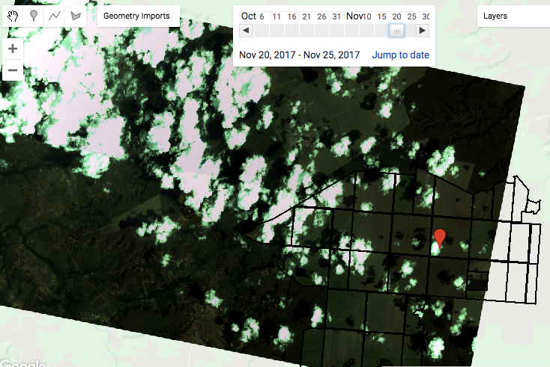
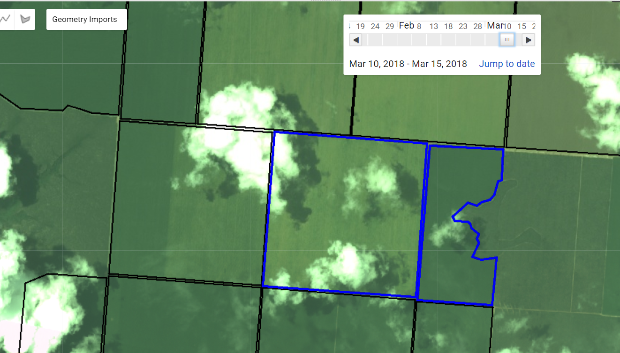
Notes on creating validation data
This week, worked on poly1 crop timing info. Take pictures of the data from each field and enter them all at the same time; can’t guarantee the code will be running for the many hours it takes to create a timing validation dataset
In some images, there’s a green sheen over the entire image so need to compare the field to the natural vegetation to see whether the field is actually green
The use of images from different satellites, and the presence of clouds (and therefore a change in visualization params) makes it hard to have temporally consistent images – i.e. sometimes a field will look like it’s mature one day but totally green next week, which means the ‘mature’ day was probably green and was just sensed with another satellite.
Try to download from the same satellite, and low presence of clouds. 4bandPSanalytic looks the best; there seems to also be more PS than RE images. Reortho and Psortho both have had some images that look ‘greenwashed’. In the future, before stepping through images to get timing, pay attention to what the images look like (compared to natural vegetation, known bare/harvested regions, etc)
Don’t download images within 5 days of each other because won’t be able to step through them (I have 5 days as the step interval)
Reorthoanalytic and PSorthoAnalytic both have greenwash effect sometimes. Pay attention to how the image looks in Planet website.
Note that sometimes dark green vegetation can look black/brown; look at natural vegetation to see whether a very dark field might actually be a very green field
Sometimes a stripe-y lightly green field won’t pick up on some satellites and it’ll look bare
Don’t download images with significant cloud cover because it will mess up the visualization parameters, making the rest of the image look too dark to see anything.
Download an entire year from Aug 1 to July 31, because there might be many cycles of crops at unusual times. Look at all times of greening in an image to make sure get all the important images.
GEE file: LandCover/Planet Create Validation Data v2
Lots of clouds -> visualizing based on 90th percentile will make image look weird. This is 4bandPSAnalytic
PS Ortho Analytic greenwashed example

Slide 22
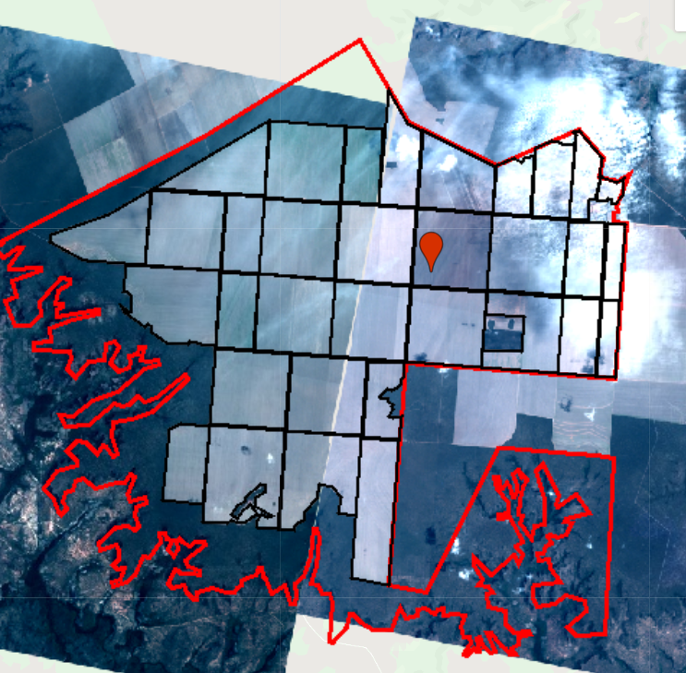
Notes on creating validation data
Careful – two images of the same field look different, have different levels of green in them! Takeaway is that it may be helpful to have a set satellite and a set vis params to make sure everything is consistent? Also, clouds in the right image might be getting in the way of accuracy in the color appearance. A simpler way is to be wary of things that look at little bit green, since it might actually be bare.

Slide 23
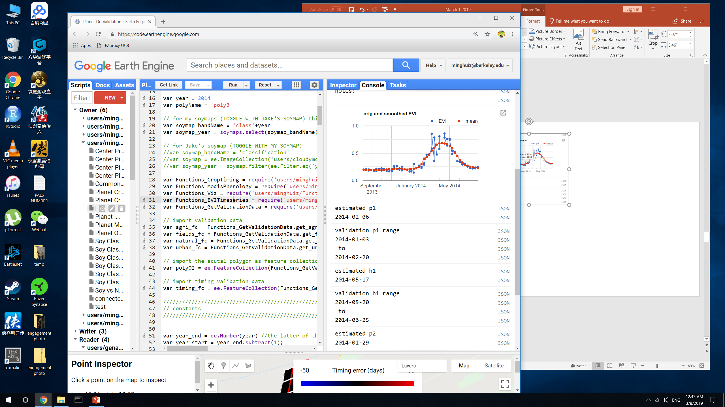
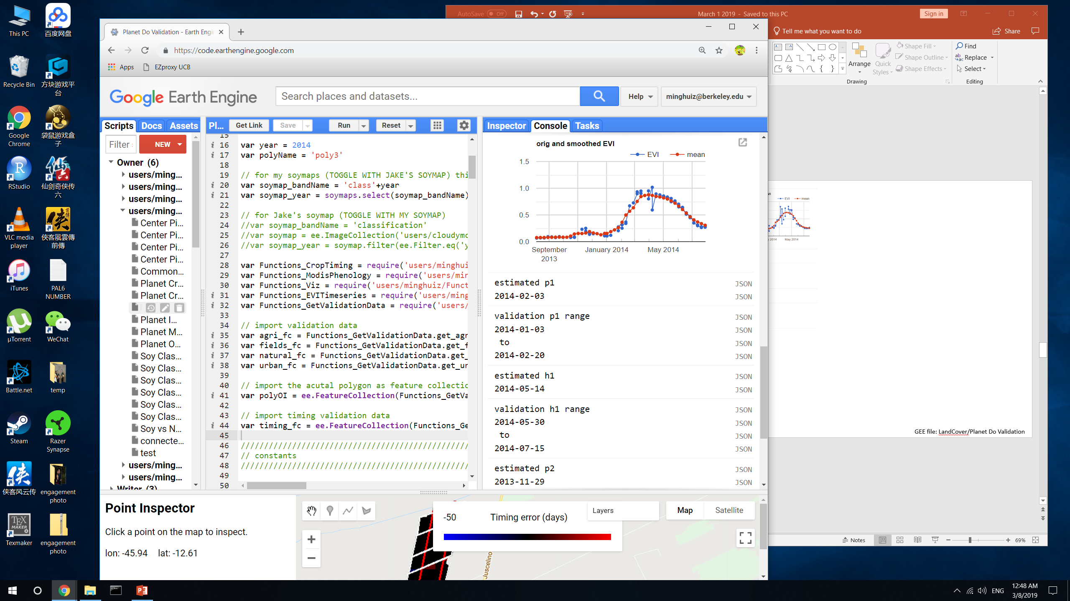
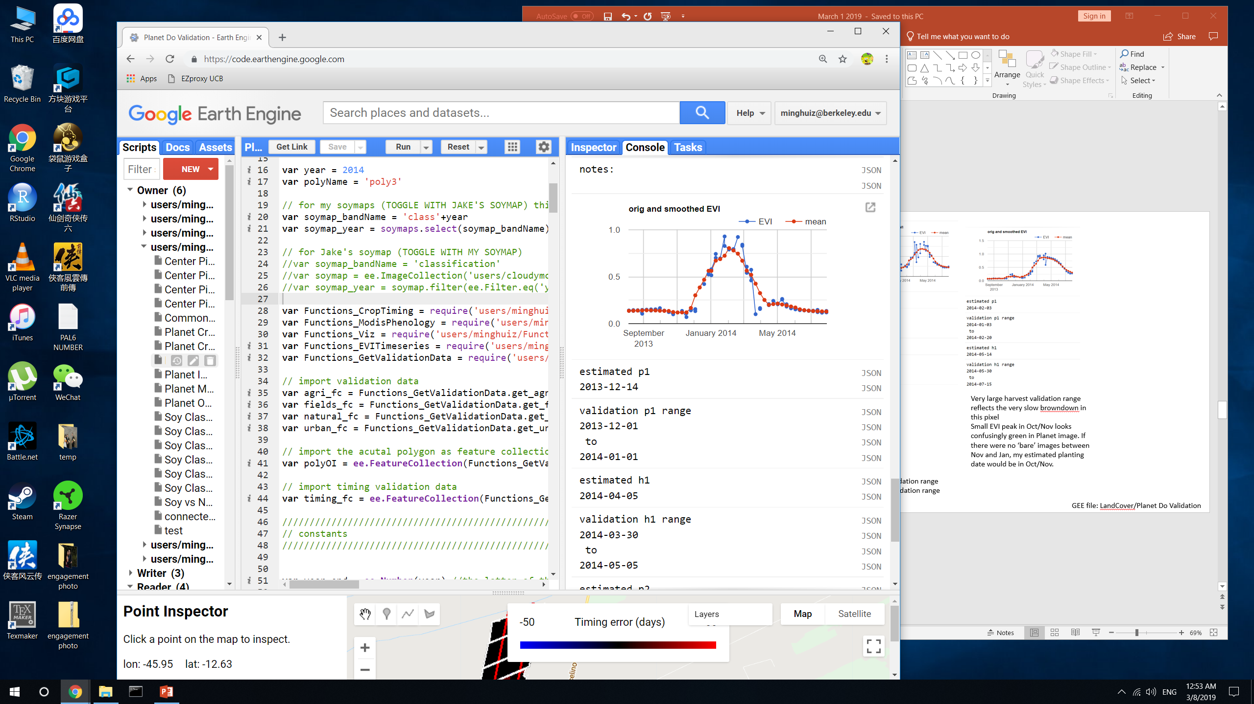
Crop timing examples
poly3 (Bahia)
Very large harvest validation range reflects the very slow browndown in this pixel
Small EVI peak in Oct/Nov looks confusingly green in Planet image. If there were no ‘bare’ images between Nov and Jan, my estimated planting date would be in Oct/Nov.
Estimated planting date tends toward the late part of the validation range
Estimated harvest date tends toward the early part of the validation range
GEE file: LandCover/Planet Do Validation

Slide 24
Creating 2018 land cover and crop timing maps

Slide 25
Need to make 2018 land cover and timing maps because most Planet imagery with high temporal resolution is 2017-2018
For land cover map, used GEE file LandCover/Soy Classification Trial 1
Mask soy_pts_agsat_1 with mapbiomas3 agri
Chose to use soy_pts_agsat1 over soy_pts_1. soy_pts_agsat_1 produced higher accuracy than soy_pts_1 (e.g. 70% vs 60%) but soy_pts_1 has some data in Matopiba whereas soy_pts_agsat_1 doesn’t. The training points will eventually change so it doesn’t matter that much.
Train classifier using Jake’s method/inputs. Classifier to be trained using samples from all years (pooled); however, each year splits the sample points into training/testing points differently
NOTE, don’t have 2018 mapbiomas3 so had to replace it with 2017 mask
NOTE, each year seems to have different training information (i.e. training points have 295 or 294 properties depending on the year) – choose a set of training information that’s common to all years or separate classifier by groups of years with the same info?
Mask final classified image with map3 agri
Export asset as LandUse/base_soymap_agsat_year
In GEE file LandCover/Soy Classification Masking, take the individual years’ base_soymap_year assets and turn them into a single image collection called base_soymaps.
For crop timing map:
GEE file Timeseries_Analysis_Modis/Timeseries Analysis v10 (difference from v9: for 2018, exports unmasked crop timing estimates, i.e. there’s an estimate for every pixel in Brazil. For 2003 to 2017, exports crop timing estimates masked by mapbiomas 3 agri, class 19)

Slide 26
In trying to pool different years’ worth of training data to train a single classifier, get different sets of training bands/properties.
This table is to figure out which years a different from the others
Year | Max # properties | Min # properties | # training points before filtering for # props = 295 | # training points after filtering for # props = 295
2003 | 294 | 294 | 1223 | 0
2004 | 295 | 295 | 1223 | 0
2005 | 295 |  | 1266 | 1266
2006 | 295 |  | 1316 | 1316
2007 | 295 |  | 1388 | 1388
2008 | 295 |  | 1415 | 1415
2009 | 295 | 295 | 1449 | 1449
2010 | 295 | 295 | 1436 | 1436
2011 | 295 | 295 | 1439 | 1439
2012 | 295 | 295 | 1449 | 1449
2013 | 295 | 295 | 1521 | 1521
2014 | 295 | 295 | 1520 | 1520
2015 | 295 | 295 | 1543 | 1543
2016 | 295 | 295 | 1564 | 1564
2017 | 295 | 295 | 1565 | 1565
2003 seems to have less data than the later years, so train a classifier for 2003 and apply it to 2003 alone; then train another classifier for 2004-2017 pooled and apply it to 2004 - 2018
GEE file LandCover/Soy Classification Trial 1

Slide 27
Additional ground reference data for land cover classification

Slide 28
 | PLOS MT | Soy_pts_agsat_1
Description | Only in Mato Grosso (is the ‘new one’) | Only in Mato Grosso
GEE asset id | users/minghuiz/LandUse/MT_ground_reference_data_PLOS_2017 | users/cloudymccloudface/cohnlab/agroserv/soylc_train_pts_agsat_1
Years | 2005 – 2013 | 2003 - 2017
Property name | clsidYEAR (YEAR = 2005 to 2013) | class
soy-single | 2 | 0
Soy-double | 1 | 1
Agri, nonsoy | n/a | 2
Cotton | 3 | n/a
Pasture/cerrado | 4 | n/a
Soy-cotton | 9 | n/a
Unknown value | 0 | n/a
Reclassify PLOS MT to match soy_pts_agsat_1
Create a single training point for each year instead of lumping multiple years
For the original unknown value, change 0 to -1 and delete that year’s data
GEE file LandCover/Soy Classification Trial 2

Slide 29
Next

Slide 30
General problems with land cover classification:
1. Training data are few (especially outside of MT) and perhaps erroneous
New MT training data from Avery
Pool existing training data across years
Create new training data from:
Planet images
Google Earth Pro (visual inspection for soy vs nonsoy)
2. Don’t know what characteristics can best separate classes
Spectrally: Band by band scatterplots to get vegetation index
Phenologically: Temporal principal components
Trial and error: Test different input data

Slide 31
Issue 1: soy vs nonsoy classification is inaccurate
Not enough training data for soy vs non soy in original dataset
There’s a lot of timing variation within soy, perhaps more than for soy vs nonsoy
Solution:
Use new training dataset based in MT (GEE asset ‘MT_ground_reference_data_PLOS_2017’, 675 points from 2003 to 2015)
Train a single classifier across years (to pool up nonsoy agri training points)
Improve the input data by determining what separates soy from nonsoy
Spectrally: Create band-by-band scatterplots using Sentinel in GEE. Look at multiband indices.
Phenologically: Temporal principle components applied to individual pixels to find principle trajectories that give the most variation
See the full variety of soy vs non soy timing. See whether SC/DC soy varies more than soy vs nonsoy
Use this information to update input data (right now: 8 day aqua composite + 32 day Landsat NDVI + terrain)
Create new soy vs nonsoy training in Matopiba and other areas of Brazil
Visually: Take the set of existing training points and look in Google Earth Pro for row patterning of soy vs nonsoy to create new training points
Search for more ground truth data… upcoming survey of soy farms in Brazil
Issue 2: SC soy vs DC soy classification is inaccurate
Sensitive to the set of input training points. Potential reasons:
Training points aren’t capturing the range of SC vs DC, or are badly geolocated
Input bands aren’t temporally refined/appropriate
Solution:
Generate training data for crop intensity, especially outside of MT, using Planet imagery. Pay attention to triple cropping/failed first crops – add more nuanced crop intensity classifications. Add in new training dataset (PLOS) for MT. Use these to redo SC/DC classifications.
Temporal principle components: categorize trajectories of SC vs DC to pinpoint what can best separate them in each region
New input bands:
Peak detection method -> dates of peaks (use dates of certain events, in addition to actual EVI values, as training)
Sentinel 2 (higher temporal resolution)
Issue 3: center pivot classification
Solution:
Take the difference of the annual min and max EVI, use the difference to find the circle. Then do object based classification of the circle in GEE. Try this with Sentinel for higher revisit time compared to Landsat (get irrigation in recent years)
Doesn’t solve raster -> vector issue at scale, but could avoid certain densities of center pivot using only the raster layer
Ask Jill Danes at Stanford about center pivot in Brazil

Slide 32
Next:
Under OBIA script in GEE training, for object based image analysis, see if can automatically get me individual fields
Ask Gabriel if can visually see difference between soy and nonsoy, and list all the potential nonsoy crops options
For center pivot detection, normalize the difference in max and min EVI. Also try to keep the object oriented classification as an image with integers as band values to prevent the raster to vector conversion that’s so hard to scale up
Select new Planet imagery locations in Mato Grosso
Dense area of soy training points
NEXT Planet image downloads:
For poly6 to 8 (based on soy_pts_agsat1), only download for 2016-2017. these are in MT
Download more matopiba soy polys (poly 2 and 4) for any year
Colab: best way to use Python API with GEE (ipython notebook server)
Do pip install earthengine-api in colab to get virtual machine
Import ee
ee.Initialize()
ee.batch.Task.list() – proves can use earth engine
Docs: github/earthengine-api -> python -> examples -> ipynb -> example stuff

